Slide 1


How to Study The Bible Relationally
Love Like Jesus
© Copyrighted, In His Grace, Inc., Houston, Texas 2016 All rights reserved.
Reproduced under license to Lead Like Jesus from In His Grace, Inc.

Slide 2
Follow up Quiz on “I Am”
In a recent best selling novel entitled, “The Killing of Jesus”, the author suggests that Jesus never confirmed that he was the Messiah. However, Jesus frequently used the term “I Am” in defining who he was. How many times does Jesus use this label to describe himself?
1) 39
2) 77
3) 153
4) 365
Right answer: 153 times

Slide 3

Profiling Biblical Characters

Slide 4
Profiling Biblical Characters
Focus on passages that describe human behavior.
Accept the recorded biblical behavioral account as accurate.
Initially, select passages that describe an unusual event that includes a fearful response followed by a unique contrasting behavioral reaction.
Note specific traits that would accurately describe the actions or responses of biblical characters and associate them with words on the DISC continuums.
Determine whether these traits cluster on the four DISC continuums into definable behavior profile.

Slide 5
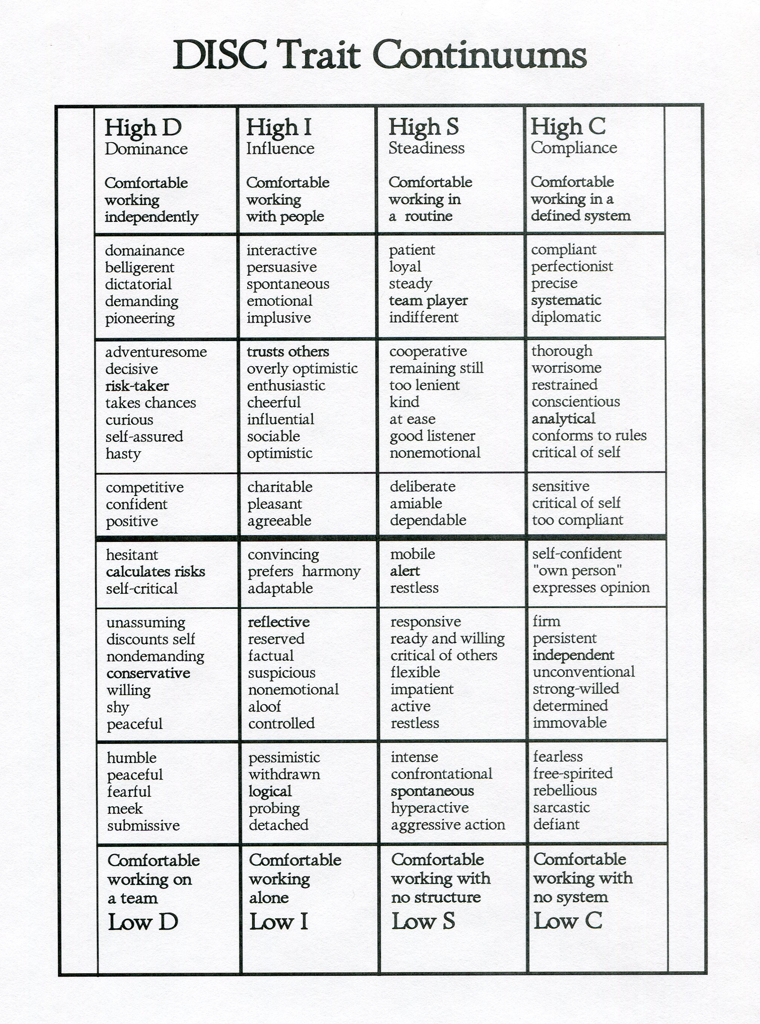
Midline

Slide 6
Your initial assignment
You will be asked to profile the actions of the Apostle Peter and observe how Jesus responded to him in love.
In doing this, you will be initially directed toward passages that have the three specific descriptions in them. They are:
1. An unusual event
2. A fear reaction to the event
3. A unique or contrasting response to that event

Slide 7
Apostle Peter Case Study
Your assignment is to read Matthew 14:22-33 and focus on Peter’s actions in verses 28-30 and describe what he did.
25 “Shortly before dawn Jesus went out to them, walking on the lake.
When the disciples saw him walking on the lake, they were terrified. ‘It’s a ghost,’
they said, and cried out in fear.
27 But Jesus immediately said to them: ‘Take courage! It is I.’
28 And Peter answered Him and said, ‘Lord, if it is You, command
me to come to You on the water.’
29 And He said, ‘Come!’ And Peter got out of the boat, and walked
on the water and came toward Jesus.
30 But seeing the wind, he became afraid, and beginning to sink,
he cried out, saying, ‘Lord, save me!’”

Slide 8
What do you observe?
  What was unusual in the passage?
  Walking on water
  Is fear present?
  Yes
  How many people were in the boat?
  12
  How many people got out of the boat?
  1, Peter
  Could that be a contrast in response?
  Yes
  Your assignment Explain why!
Shortly before dawn Jesus went out to them, walking on the lake.
When the disciples saw him walking on the lake, they were terrified. “It’s a ghost!” they said and cried out in fear.
Peter replied,‘Lord, if it’s you tell me to come to you on the water.’ …Then Peter got out of the boat and walked on water and came toward Jesus.

Slide 9
Why is that important?
If you understand “why” Peter did what he did, then you can also determine his strengths, limitations, fears and blind spots
But most importantly “how” to love him
That’s what this study is about

Slide 10
Peter
A Behavioral Case Study
Assignment: look at the three traits in each of the following four continuums and place a circle around the words in each group that best describe Peter's behavior.
-
D Pioneering risk-taker
Adventuresome risk-taker
Decisive risk-taker
I Acting out of emotion
Acting out of trust
Acting out of optimism
S Being energetic
Being spontaneous
Being hyperactive
C Independent decision
Unconventional decision
Determined decision

Slide 11
Peter
A Behavioral Case Study
Based on your selections, put the terms together in a sentence to describe what Peter did.
In getting out of the boat, Peter was a _________ risk-taker while acting out of ________ Jesus’ word. Being ____________________ his behavior
demonstrated an _____________________ decision as he began to walk on water toward Jesus.
Based on your choices, find the traits that you selected on the DISC continuum on the opposite page. Do the traits immediately above and below the words you selected describe what Peter did?

Slide 12
Peter
A Behavioral Case Study
Based on your selections, put the terms together in a sentence to describe what Peter did. Below is an example:
In getting out of the boat, Peter was a decisive risk-taker while acting out of trust of Jesus’ word. Being spontaneous, his behavior demonstrated an independent decision as he began to walk on water toward Jesus.

Slide 13
Based on your choices, find the traits that you selected on the DISC continuum on the next page. Do the traits immediately above and below the words you selected describe what Peter did?

Slide 14
Midline

Slide 15
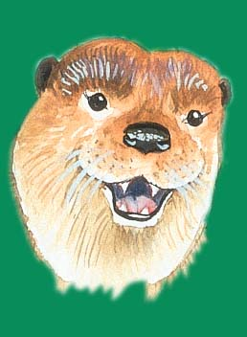
“D” Continuum
^{28 And Peter answered Him}
^{and said, ‘Lord, if it is}
^{You, command me to}
^{come to you on the water.’}
^{29 And He said, ‘Come!’}
^{And Peter got out of the}
^{boat, and walked on the}
^{water and came toward}
^{Jesus.}
^{30 But seeing the wind, he}
^{became afraid, and}
^{beginning to sink, he cried}
^{out, saying, ‘Lord, save}
^{me!’”}
adventuresome
decisive
risk-taker
takes chances
curious
Midline
Fine the “D” traits
on the
“D” continuum

Slide 17
“I” Continuum
²⁸ And Peter answered Him and said, ‘Lord, if it is You, command me to come to you on the ^{water.’}
^{29 And He said, ‘Come!’}
^{And Peter got out of the}
^{boat, and walked on the}
^{water and came toward}
^{Jesus.}
^{30 But seeing the wind, he}
^{became afraid, and}
^{beginning to sink, he cried}
^{out, saying, ‘Lord, save}
^{me!’”}
quick to comment
emotional
trusts others
overly optimistic
Midline
Find the “I” traits
on the
“I” continuum

Slide 19
“S” Continuum
²⁸ And Peter answered Him and said, ‘Lord, if it is You, command me to come to you on the ^{water.’}
^{29 And He said, ‘Come!’}
^{And Peter got out of the}
^{boat, and walked on the}
^{water and came toward}
^{Jesus.}
^{30 But seeing the wind, he}
^{became afraid, and}
^{beginning to sink, he cried}
^{out, saying, ‘Lord, save}
^{me!’”}
Find the “S” traits
on the
“S” continuum
Midline
intense
energetic
spontaneous
hyperactive
dynamic

Slide 21
“C” Continuum
²⁸ And Peter answered Him and said, ‘Lord, if it is You, command me to come to you on the ^{water.’}
^{29 And He said, ‘Come!’}
^{And Peter got out of the}
^{boat, and walked on the}
^{water and came toward}
^{Jesus.}
^{30 But seeing the wind, he}
^{became afraid, and}
^{beginning to sink, he cried}
^{out, saying, ‘Lord, save}
^{me!’”}
Find the “C” traits
on the
“C” continuum
Midline
Persistent
Independent
Unconventional
Determined

Slide 23
DISC Blends & Biblical Characters –
Biblical Behavior Assessment page 26
DISC BLENDED PROFILES BIBLICAL CHARACTERS
Primary D – SOLOMON, RAHAB*
D/I - JOSHUA, SARAH
D=I - APOLLOS, STEPHEN, LYDIA*
D/C – PAUL, RACHEL, MICHAL*
Primary I - AARON, KING SAUL
I/D - PETER, REBEKAH*
I/S - BARNABAS, ABIGAIL
I/C - DAVID, MIRIAM*
S or S/C - ISSAC, DORCAS*
S/D - NEHEMIAH, MARTHA
S/I - ABRAHAM, HANNAH
S/C/D – JACOB, JAMES [ACTS 15], ANNA*
C or C/S - LUKE, ESTHER
C/S/D - MOSES, THOMAS, NAOMI*
C/S/I - ELIJAH, DEBORAH*, RUTH*
C = S – APOSTLE JOHN, MARY (mother of Jesus)

Slide 24
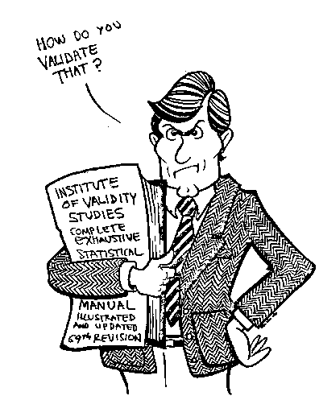

Slide 25

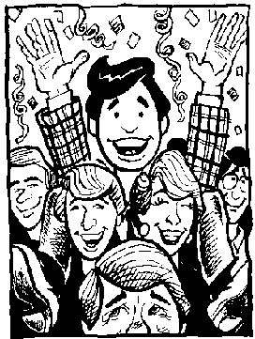
1. Each style has its own unique response to pressure.
High I/D’s express feelings by talking
High I/D’s also enjoy having fun!

Slide 26
Validation of Peter’s Behavior Style
In the process of validating Peter’s behavior, one should look for a second, separate instance where an unusual event happens and where fear is also present with a contrast in response to that of others present.
If Peter’s behavioral profile is that of an I/D profile, the behavior traits that should be somewhere in the biblical account are:
  Spontaneous, unsolicited expression of feelings
  If positive, wanting to celebrate with a fun, social event

Slide 27
Matthew 17:1-3
“Now after six days Jesus, Peter, James, and John his brother, brought them up on a high mountain by themselves. There he was transfigured before them. His face shone like the sun, and his clothes became as white as the light.
And behold, Moses and Elijah appeared to them, talking with Jesus.”
What is unusual about the passage?

Slide 28
Under pressure it is normal for
High I’s to express their feelings!
Luke 9:32-33, Mark 9:2-6, Matt. 17:1-9
“Peter and the other disciples had been sound asleep…all at once they woke up and saw how glorious Jesus was. They also saw the two men who were with him.
Moses and Elijah were about to leave, when Peter said to Jesus, ‘Lord it is good for us to be here; if You wish, let us make here three tabernacles; one for You, one for Moses, and one for Elijah.’ But Peter did not know what he was talking about…for they were all terrified.”

Slide 29
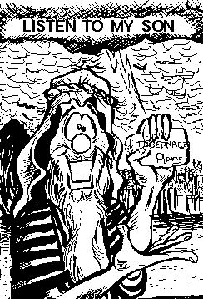
God the Father’s response!
Luke 9:34, Matthew 17:5
“ While Peter was still speaking behold, a bright cloud over-shadowed them; and suddenly a voice came out of the cloud, saying,‘This is My beloved son, in whom I am well pleased. Hear Him!’”
What does the Lord’s response suggest to you?

Slide 30
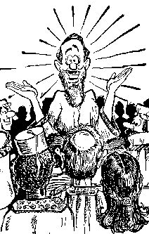
2. Each style has its own set of unique strengths.
Can God use
a person’s
strengths for
His purpose?

Slide 31
Bible Quiz
Jesus frequently used questions to stimulate dialogue. How many of Jesus’ questions are recorded in the gospels?
1) 39
2) 77
3) 153
4) 365
Right answer: 153 times

Slide 32
Example of Jesus using a question directed toward the disciples
Matthew 16:13-14 (NIV)
13 When Jesus came to the region of Caesarea Philippi, he asked his disciples, "Who do people say the Son of Man is?"
14 They replied, "Some say John the Baptist; others say Elijah; and still others, Jeremiah or one of the prophets."

Slide 33
Jesus using a follow-up question with a reference to “I Am”
Matthew 16:15-17 (NIV)
15 “ ‘But what about you?’ he asked. ‘Who do you say
I am?’
16 Simon Peter answered, ‘You are the Messiah, the Son of the living God.’
17 Jesus replied, ‘Blessed are you, Simon son of Jonah, for this was not revealed to you by flesh and blood, but by my Father in heaven.’ ”

Slide 34
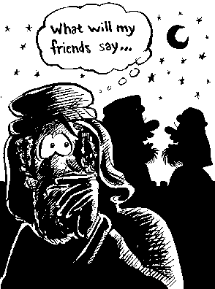
3. When out of control, these unique strengths
can become each style’s greatest weakness.
Can Satan use
a person’s
strengths for
his purpose?

Slide 35

An example of a High I’s verbal skills
being used by Satan.
Matthew 16:21-23 (NIV)
“From that time Jesus began to show to
His disciples that He must go to Jerusalem, and suffer many
things from the elders and chief priest and scribes, and be
killed, and be raised again the third day.
Then Peter took Him aside and began to rebuke Him,
saying, ‘Far be it from You, Lord; this shall not happen to You!’
But He turned and said to Peter, ‘Get behind Me,
Satan! You are an offense to Me, for you are not mindful of
the things of God, but the things of men.’ ”

Slide 36
Lead Like Jesus defines 2 types of EGO
EGO – Exalting God Only
“Seeking to lead for a higher purpose”
“Seeking the promised guidance of the Holy Spirit as the
ultimate Coach”
EGO – Edging God Out
“Fixation on short-term results at the expense of long-term
integrity”
“Having an overblown view of your ability or desire to control
events”
Do you see both EGOs expressed in the case study?
Were the traits used by Peter the same or different?

Slide 37
“Unguarded strength is a double weakness.
The Bible characters fell on their strong
points, never on their weak ones.”
Oswald Chambers

Slide 38
4. In addition, each style has a unique set of blind spots.
Matthew 26:31-35 (NIV)
“Then Jesus told them,‘This very night you will all fall away on account of me, for it is written:
‘I will strike the shepherd, and the
sheep of the flock will be scattered.’
But after I have risen, I will go ahead of you into Galilee.’
Peter replied,‘Even if all fall away on account of you, I never will.’
‘Truly, I tell you,’ Jesus answered,‘This very night, before the rooster crows you will disown me three times.’
But Peter declared,‘Even if I have to die with you, I will never disown you.’ ”
Do you see any pride in Peter’s statement?

Slide 39
5. The very best one can do to help others is to create an environment which allows specific styles to become aware of their strengths, weaknesses and blind spots.
[Luke 22:31-34, 54-61a
“‘Simon, Simon, Satan has asked to sift you as wheat. But
I have prayed for you…’
Peter replied,‘Lord, I am ready to go with you to prison and to death.’
…later that night another asserted, ‘Certainly this fellow was with him, for he is a Galilean.’
Peter replied,‘Man, I don’t know what you’re talking about!’ Just as he was speaking, the rooster crowed.
The Lord turned and looked straight at Peter.”

Slide 40
6. For the Spirit to control the person, the unique, sinful part of each individual’s style must be broken.
[Matthew 26:75, Luke 22:62, Mark 14:72
“Then he began to call down curses on himself and he swore to them, ‘I don’t know the man!’
Immediately a rooster crowed…
...The Lord turned and looked straight at Peter.
...Then Peter remembered the word Jesus had spoken to him: ‘Before the rooster crows today, you will disown me three times.’ And he went outside and wept bitterly.”

Slide 41
Once brokenness occurs, only then does an individual become teachable
The challenge of a master/teacher is to understand how to create the right environment, so that the teachable individual is self motivated to produce positive behavior modification.

Slide 42
What does brokenness look like?

Slide 43
Observations of the John 21 Case Study
Speed of Peter’s speech - (fast or slow)
Was Peter’s speech logical and non- demonstrative, or random and animated?
Describe the tone presented by Jesus – (friendly and patient or confrontational)
Was an action plan mentioned?
Was grace presented?
Was it deserved?
Did Peter finally get it and become teachable?

Slide 44
Questions are:
Do people like Peter exist today?
If so, how do you fix them?
Better question:
How do you love them?

Slide 45
Where we are headed
It is through Scripture that you come to know God and His ways. In the pages of His Word, God invites you to know Him and experience His love…The study of Scripture equips us to fulfill God’s plan for us. Scripture also instructs us how to treat one another, how to love as we have been loved, and, yes, how to Lead Like Jesus...We pray that today you will begin the adventure of knowing God through Scripture.
Ken Blanchard, Phil Hodges, Phyllis Hendry, Lead Like Jesus Revisited,
(W Publishing Group), page 105.

Slide 46

TIME FOR A BREAK

