Slide 1




Slide 2


Keep your video on. Mute yourself except when talking.
Avoid eating during the session; it’s ok to enjoy a beverage.
Take notes and fully participate. Silence your other electronic devices. Focus, and avoid multi-tasking.
View your facilitator, small group leaders, and producer as a resource. Text chat any requests privately to us.
Please help us out by being diligent about timing!
Notes:
So, as we said about this particular webinar, we said, what are some of the challenges and issues that people are facing today in the workplace, in our churches, in our ministries, in our homes

Slide 3

THE PROBLEM?
85% of employees deal with conflict
29% say they deal with it constantly
27% have seen conflict lead to personal attacks
25% have seen conflict lead to illness/absence
AND … 49% of conflict is a result of
personality clashes and “warring egos”
*CPP Human Capital Report
Notes:
and conflict just seems to be one of the big ones. And, um, this is fascinating information from consulting psychology, just press in their human capital report. A couple of years ago, a survey of several thousand people, 85% say they deal with conflict. 29% deal with it. Constantly 27% have seen it lead to personal attacks. And 25% say conflict has led to their illness or absence in the workplace. And what really fascinated me about this is that nearly 49% of conflict, at least according to this study is a result of personality, clashes and waring egos. And that's our topic for today because disk is a great tool model to look at personality, we call it behavioral style.
Speaker 1: We're not gonna dig deep into your psyche today with personality, which goes deeper, but what are your observable behaviors and what causes those waring egos from time to time, just because we do things differently because we're wired differently.

Slide 4
TODAY’S SOLUTIONS/AGENDA
Discover your unique behavioral style.
Better understand how God created you, with your strengths, weaknesses and innate conflict responses.
Explore ways to build positive relationships and minimize conflict.
Adapt your behavior to meet the needs of others.
  Love as Jesus Loved
Notes:
And so what we'd like to propose to you is a solution through our agenda today, you'll have a chance to discover your unique behavioral disc style, better understand how God created you. What are your strengths, weaknesses, and innate conflict responses. They are different depending on style. Very often. We'll explore ways to build positive of relationships and minimize those conflicts. Um, we do that through adapting our behavior through meeting the needs of others and in short bottom line to love as Jesus loved. And that's one of the things that we enjoy about this model

Slide 5



Your Biblical DISC® Report & Handout
Notes:
is that it really gives us Jesus as our example. But once again, you'll need these two is of information, your disc report, biblical disc report, the assessment report and your handout.
Speaker 1: I'll try to say assessment or handout. So we stay together, uh, as we go through our time together, if you do have questions by the way, feel free to text chat. Those we'll do our best to answer them as we go along.

Slide 6

P.3: Key Principles of DISC
  There is no “best style” - all have value.
  Style is influenced by other factors - values, life experiences, and spiritual maturity.
  Three keys to effectiveness = understanding your style, learning others’ style, and learning to adapt your behavior
  God’s Word = final authority in dealing with people and their behavior.
Notes:
Join me now in your assessment report. And, uh, the first inside page is a table of contents page, which just shows you the three main sections of this report. Uh, the middle one is what makes it biblical. And that's, what's unique about this over other disk and other models like Myers, Briggs, engram, and those types of things. Here's some things as we believe at the bottom of page three, in terms of the disc model itself, there is no best style. Certainly all have value. We believe God created us differently so that we know how to get along and get best results.
Speaker 1: And of course we all are a combination of all four of those. And we'll talk more about that. Style is certainly influenced by other factors. So I mentioned, we're not going deep into personality today. We're not looking at your values, for example, what we are talking about, um, your observable behavior, but your values, your life experiences, your spiritual maturity for hopefully for price followers, all of these things, uh, will influence, uh, the way we act. And today we look at observable behaviors. There's three keys to being effective with this first understanding our own style, sec, learning the style of others, and then learning, how do I adapt my behavior? That's the real get right here, adapting, meeting the needs of others. And very importantly, God's word is the final authority in dealing with people and their behavior. So we always point people back to scripture.
Speaker 1: If there are questions about working with, and with people,

Slide 7
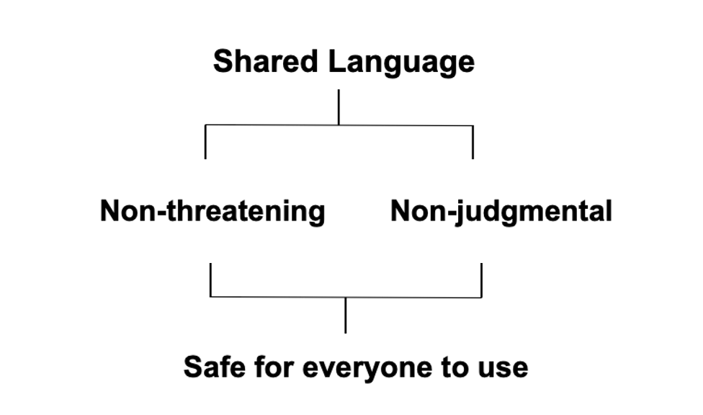
DISC = Shared Language
Notes:
we like dis because it is a shared language it's non-threatening and nonjudgmental, it's safe for people to use. There are many other models similar in the marketplace. I know you're familiar with a number of these. Um, we found disk to be very practical and people can get it pretty quickly. And it's therefore very easy to put, to work in a work, setting, a ministry, setting those kinds of things.

Slide 8
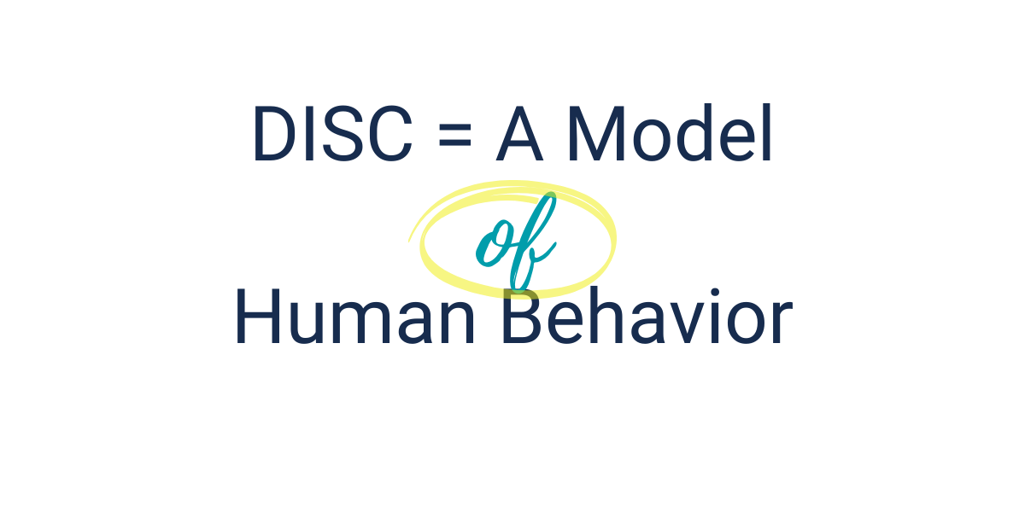
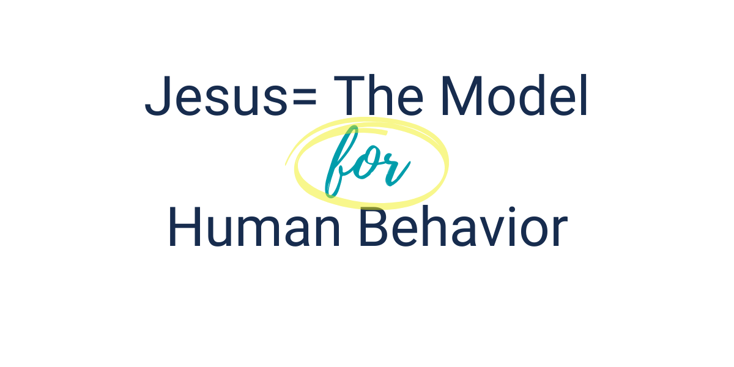
Best Source for Understanding Behavior & Relationships
Notes:
We do wanna qualify it however, and say, while dis is really a very good model of human behavior, we would suggest that Jesus is the model for human behavior. And so we continue to point back to him as our perfect model.

Slide 9
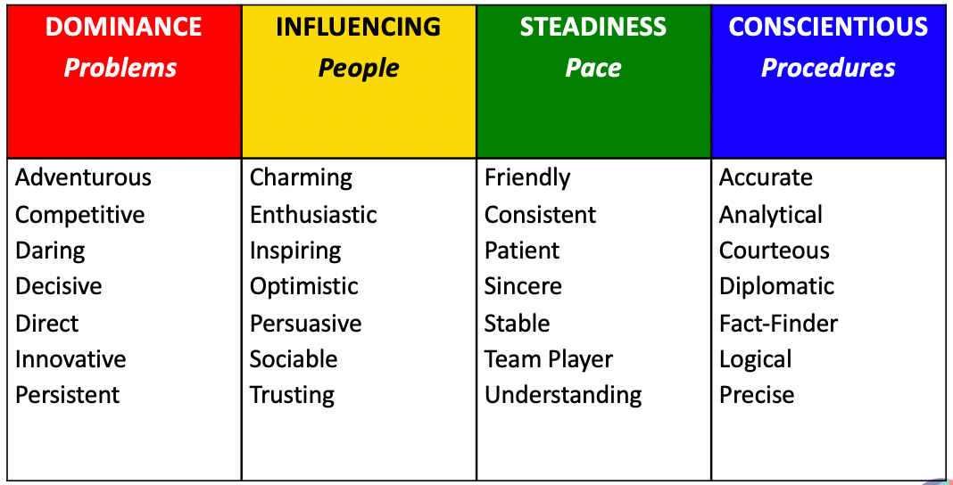
P.4: Understanding DISC
Notes:
So let's begin to understand something about the disc model itself. Join me on page four of your assessment here. You will see what D I C stands for, what the focus is of each of the styles.
Speaker 1: These love solving problems, dealing with how to overcome issues and challenges and problems. Eyes are more intent on people, issues and being involved in interacting with people, SS the steadiness style, more pace, consistency, keeping things stable and calm, and sees love procedures and, uh, dealing with detail and being thorough and accurate. And you see some of those characteristics popping up here underneath in the columns. So these would be characteristics that somewhat define what those styles look like in terms of behavior.

Slide 10
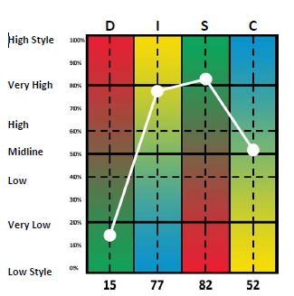
P.6: Natural Behavior
Your private self: most true and
accurate you;
your sweet spot
Notes:
We're gonna jump now to page six, and this is where it starts to get really interesting because now we're learning about, okay, what does this say about me based on how I answered those 30 question? What is this telling me about myself? This happens to be my graph two, which we call natural behavior, which you're seeing on page six. This is what we say the most true and accurate view.
Speaker 1: If you don't have other forces or people influencing your behavior, what are you like most of the time? So this is kind of your sweet spot. Notice for me. I have a unique combination of three points above the midline. So influencing steadiness and conscientious are all above this middle line. This makes them more observ behaviors. I have less of the dominance that takes more energy for me. It weigh its way down here usually is where it is. And at the bottom, you're just getting percentages, how much energy you tend to put into those types of behaviors. Most of you will have one, maybe two of these plotting points. We above this midline, this solid midline, but this gives you a sense of, of how you fall, uh, in that particular situation. So we'd like to give you a chance to begin to understand more about yourself, talk about it with, uh, some colleagues. what I'd like you to do back on and six for just a minute circle, the highest plotting point, the highest point on your graph. In my case, it's the C here. And in my case, I have two more that are quite high. So I just maybe circle or put a box around these two as well, but circle the highest one visually on the graph, the highest percentage.
Speaker 1: So in a minute, I'm gonna put you into some breakout rooms.

Slide 11
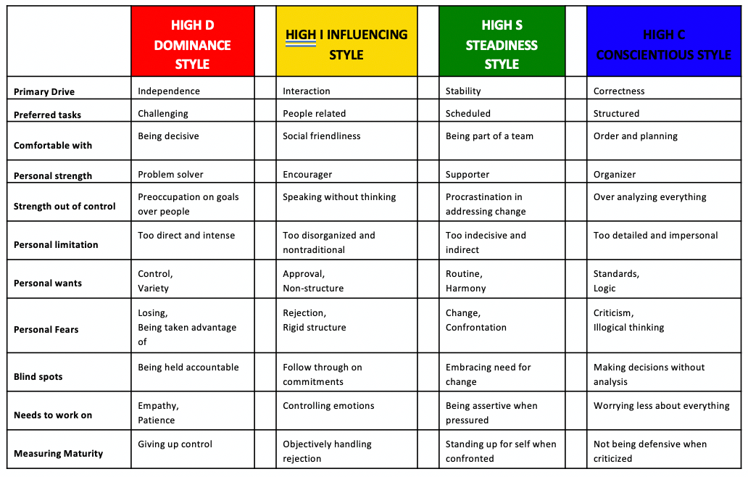
P.8: Overview of DISC Styles (+, -, ?)
Briefly introduce yourself, and then share: Your +, - and ? for your high style, + 1 example of how your D,I,S, or C style shows up at work.
Notes:
And then try answer that to page eight. So turn over a page. What we're gonna do now is personalize. This you'll notice down the left side are some categories of behavior, primary drive, preferred tasks, what you're comfortable with, et cetera, for each of the, uh, the columns then DS or C it's giving word or a phrase that should be somewhat indicative of you or typical of you and your behavior. I would look down the, the C column. That was my highest. If there's time, I might look down the S and the, I wanna give you just 90 seconds of silence here. Would you just take your pen or pencil and do a quick plus minus question mark plus, I agree. That's me. What minus? No, I don't think so. Question mark. You know what? I'm not sure. Take 90 seconds and do that down your highest point column. And then if you want, look at the others as well, … So hopefully you had a chance at least to work through that highest column. And in a moment, we're gonna put you into breakout rooms and have you share just a few things and, uh, you'll need to click join when you see, uh, Meg is ready to drop the into those rooms. Here's what I invite you to do. If you'd briefly introduce yourself, maybe name, city, state, or country, uh, and then share, which of the columns was your highest. Did you have a backup a second, maybe even a third above that midline. And as you went through those, maybe just share a couple of examples of, yes, this was definitely me. Here's one I wasn't so sure about or I disagreed with. And then maybe what does that look like at work? How does your disc style show up at work? Fascinating for me that even though the C was the highest on this particular graph, my S is my comfort spot.
Speaker 1: This is probably my core style. So I could put a plus mark in front of every one of the S's about half of the seas. So I would say at work, I definitely enjoy being part of a team. I do like harmony. I like to keep things steady and calm, and it's hard for me to be assertive. And so that's something that I have to work at in a team meeting recently, I thought things were going a little slow and I actually, uh, check the boss to move things along. Um, that took a lot of courage for me. Uh, so that's an area that I have to work at. So that might be an example of what you're gonna share is you go to your groups.
uh, Meg is gonna put us into some small groups about the person whose last name is towards the end of the El that being our discussion leader. What that means you just start and, uh, check your timing. I think Meg, we have eight or nine. Let's do nine minutes for this. You will get a, a warning about three minutes out. And then at 60 seconds, it'll start to clock down and come back together. What questions might I answer before you, you go to groups.
Thanks Meg. For having us hit our groups. Go ahead and click join when it comes up.
Okay. Well, welcome back everybody. I hope you had a chance to get acquainted and share some ideas about your own personal style. We love to have people be able to personalize this again. So many other factors weigh in, in terms of what influences the behavior that we share. But behavioral style is a significant part of what we do. It's just how God wired us. It, what is what comes naturally to us? What's fascinating now, as we think about this, so what does it look like when I show up at work? Does my style change at all? Do I adapt it to meet the needs of the work or do I tend to remain pretty consistent with my normal behavior?

Slide 12
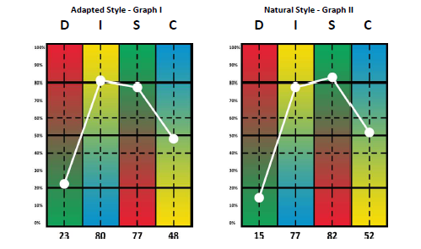
P.7: Adapted vs. Natural Style
Notes:
So back in your, a assessment now, page seven, what you're gonna look at here is a comparison between your natural style. This was your page six, your natural style graph two, and now your adapted style graph.
Speaker 1: One. If you fill this out, thinking about work with a focus on your work, uh, work world, this will then reflect how you show up at work. So my example here, remember naturally I have is, and C all above that midline. However, when I'm doing this work, I'm much more in my eye mode. What that means is I have to be more persuasive, influential, sociable people oriented. So the eye jumps up notice about 70 to 83, 13 percentage points, not a big stretch for me, but a little stretch. Uh, what we look for by the way, with stretch or stress, if you are looking at 20, 25 or more percent, either increases or decreases from graph two to graph one that could sometimes lead to some stress in our life up to 20%, 25% might be a stretch when it gets more than that, that's where stress can come in.
Speaker 1: So that would be a fascinating conversation if we were doing one-on-one coaching with you. Um, notice for me, the D actually rises a bit 14 points be cuz I have to be more assertive. I have to be concerned about accomplishing the task right now, getting things done. And what that means is because these both increase the S and the C obviously are going to decrease. So I would have three questions for you. If I were looking at your individual results first, does it make sense that you are adapting whichever way you are number two, is that working for you? In other words, if I were coaching me, I'd say, does it make sense that the, I goes up when you're doing this kind of work? Well, sure it does. Okay. Because I'm working with people and, and so forth. So number one, is it working, uh, that doesn't make sense?
Speaker 1: Number two, is it working and number three, is it causing any stress? And that's an important question because this sometimes is where burnout can happen. If we're constantly having to modify at to five 30% or more, it's typical for us to either burn out or we're really good at re-energizing or recreating at night when we leave work. And so those are some important questions for you to think about and people have different ways of dealing with stress. We, we can get into all of that if we were doing stress management. Uh, so I'm not gonna spend much time on that, but it's, it's good to think about something we love to do by the way is have those conversations with people.

Slide 13
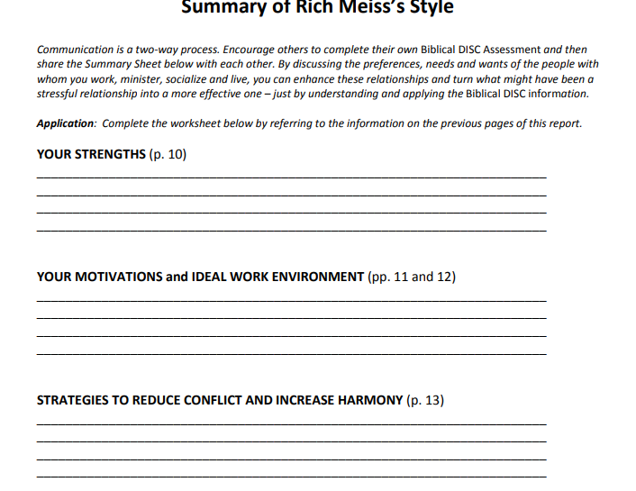
P.9-15: Personal Characteristics
  Accurate narrative description of your behavior - based on how you responded to the assessment.
  Read and personalize on your own time; transfer key points to the page 16 summary! (Review this as a team!)
  Example: On P. 13, underline or Highlight 1-2 Typical Behaviors in Conflict/Strategies to Reduce Conflict and Increase Harmony that you believe to be true of you.
  (Be ready to discuss this in your group)
Notes:
So what we're gonna do is apply this to our topic in a moment, we're gonna look at specifically, how do you deal with conflict?
Speaker 1: I wanna point out these pages in your assessment, what we call your narrative description pages. So nine to 15 looks at a whole variety of things, general characteristics on nine. Then it goes into strengths, ideal working environment, how you handle stress, how you communicate and some ideas for improvement. So this is great information. And for what we suggest here is that you read this and personalize it. So go through and do that. Plus minus question mark on your own time, maybe pick up two or three of the main points from each page and transfer them to this summary page. And this is a great exercise as a team. In our last webinar, we had several teams there. We've people on this, uh, webinar with some colleagues, sit down together, over lunch and, and just talk about this, maybe share what are some strengths you bring?
Speaker 1: What do I bring? How do we make those work together? Um, am, am I operating in my ideal work environment? Are there some ways we might change who's doing what in our team, because this would be more appealing to you, and this is more appealing to me and so forth. So great team exercise again that you might investigate or do after the webinar itself. At some point, what we're focused on today of course is conflict. So I invite you to turn to page 13, and this is gonna give you some points about what is your typical behavior and conflict about halfway down the page. And then what strategies can you use to reduce conflict and increase harmony? We're gonna have a discussion on this in a minute, take a time right now and underline or highlight just one to two of your typical behaviors in conflict. And then we'll be ready to discuss that.

Slide 14
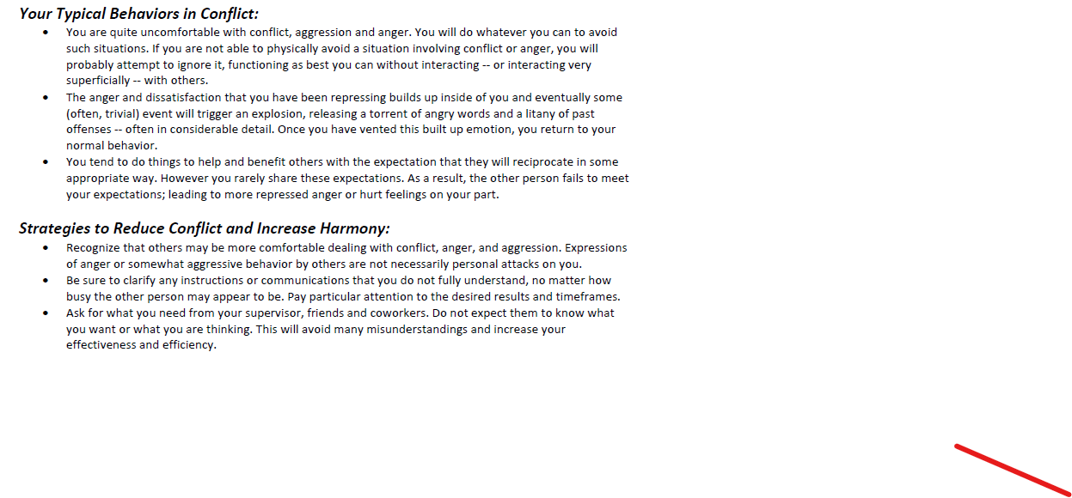
P.13: Understanding Behavior in Conflict
Notes:
So this would be mine. And I would just highlight a couple of these that I agree with in both categories. Take some time to do that, please.
So once again, we'll be joining our breakout groups and, um, maybe, um, person who's, what did I say, person? Who's. I don't even remember what I said. Somebody just start in your group and uh, just go right around, make sure you give each other time. Uh, how about we take about eight minutes Meg for this? You'll give us a three minute warning again and then a 62nd warning back. So, um, somebody just follow tier to, to lead your group. Barbara, do you have a suggestion for group leaders?
Speaker 3: How about the person who got up earliest this
Speaker 1: Morning? There you go. All right. Early riser is your person to start and go right around your group. So we'll see you back in eight, enjoy your time.
Okay. Well, thanks everybody. Welcome back. So, um, we've kind of set up now by getting some self understanding. Obviously there's a lot more to explore or in those first 15 pages, and I will encourage you to do that. Some of that working with teams or colleagues or even, uh, spouses, uh, situations like that, what we wanna do now is kind of paint a broader stroke of D I S C and give you some understanding of the different styles, how they show up what it looks like. And in terms of strengths, ideal environment, what motivates people under stress, what happens? And then what's our typical conflict response. Before we do that, I'd like to get a sense of my group here. So Meg let's do a poll and have people tell us, are they highest in D I S or C? So get it ready to click everybody. So looking at, at your graph two, your natural graph, page six, what was your highest plotting point DS or C if you have a tie on graph two, look back at graph one And we'll close that in 5, 4, 3, 2, and one.
Okay. So we have a largely S group today, 43% in the S behavior. We got 29 at, uh, uh, I 21 C. So we need a little more D behavior. Jim, I'm glad we got you here, brother. We need that D to help balance us out. So if this were an intact team, I would talk to the team about what can we do when we need to bring more assertiveness, more risk, taking more decisiveness, uh, moving forward, making decisions, uh, boldly, that kind of thing. Uh, sometimes if we're replacing or bringing new P people on replacing people or bringing new people on, it's good to look at that and, and look for a mix. Obviously, some teams need more C behavior because they're dealing with more analytical kinds of things and some might need more eye behavior, cuz they're more in a sales marketing role.
Speaker 1: So those kinds of things, all influence that. But one of the fun things you can do with this is at how do we create an ideal team by looking at that blend of style and blend of behavior.

Slide 15



Directing Style: High “D”
  1. Strengths: Risk takers, forceful, problem
  solvers, self assured
  2. Motivated by: Challenges and progress
  3. Ideal work environment: Being in control;
  getting immediate BOLD results
  4. Under stress: Lack of concern for other’s
  feelings; impatience
  5. Conflict Response: Challenges others;
  demands action
  6. Fears: Loss of control; being manipulated
Notes:
So what I wanna do now is to have you turn in your handouts and we're gonna go to page number two. So, um, let's learn a little bit about each of the styles in terms of strengths, motivation, ideal work environment, under stress and a typical conflict response. We're gonna start with our D friends because they're impatient and they wanna know about themselves. So great strengths of the DS they're risk takers. They're forceful they're problem solvers and they're self assured. I wish I had more of that confidence. Those of you that have that, it's a wonderful strength. They're motivated by challenges, progress, love to make things happen, conquer things.
Speaker 1: Uh, we use Solomon in the new Testa or in the old Testament as an example in first Kings there, all of his conquests, his, uh, building of the palace grounds and, and all of the things that he did to, to make that just an incredible kingdom, if you will. And also they're good at solving problems. I love the example of the two women who came to, you know, were brought to him because they were fighting over whose son is this? And you remember his quick decision was, well, let's cut the child in half, give half to each mother. And of course we know the outcome of that. So D just have that ability to quickly assess situations and solve problems. They love being in control and they like immediate bold results. Let's get it done. Let's make it happen. Here's a challenge for DS under stress because they go to those strengths too much.
Speaker 1: They can have a lack of concern for others feelings and be patient. So equal time thinking of an old Testament, female character, our friend, Sarah, as we all know, um, promised by God to have a son and at almost what age 90 for 25 years, that hadn't happened. I guess I would understand how someone could become impatient, but she took matters in her own hand, of course, gave, um, Hagar to her husband. And we know the outcome of that and the challenges that that's created. So there's positive and negatives of, of each of the styles. What's interesting to me is later in first, Peter, she's held out as an example of a model wife. So Sarah certainly learned and, uh, is, is held up in scripture as being a model of good behavior. So pretty cool different between, uh, ha working in the flesh and working in the, in the spirit.
Speaker 1: If you will, conflict response for DS, they challenge others and they demand action. So again, be careful here when that's outta control that lead to challenges. I'm gonna also give you a bonus for each of those. Write this for each of these four, write this underneath. Number five, the fear of the high D is loss of control or being manipulated. Don't back them into a corner. They will come out swinging. So DS love to know that they are the ones calling the shots, making the decisions being in control. That's an area that can challenge them.

Slide 16

Biblical Characters with “D” Behavior
High D BLENDS Biblical Characters
Primary D
D/I
D=I
D/C
Solomon, Rahab
Joshua, Sarah
Apollos, Lydia
Apostle Paul, Rachel
Notes:
We're gonna talk about how all of this builds into conflict in a few minutes, I mentioned these scriptural characters. This is the great thing about the biblical disc is you have on pages 25 to 33 of your assessment, great information about these characters and how God and Jesus worked with them and scripture.
And it's just fascinating to see how each person was handled carefully on his or her style. And also it's fascinating to see the strengths of that style and the benefits that brought, but also unfortunately the flip side, the limitations or weaknesses and what were some of the downsides of that

Slide 17

Interacting Style: High “I”
  1. Strengths: Optimistic, appreciative, fun,
  inclusive
  2. Motivated by: Positive experiences
  3. Ideal work environment: Being involved
  with people; positive, approving
  atmosphere
  4. Under stress: Impulsive, lack of follow
  through
  5. Conflict Response: Denies responsibility;
  shifts blame
  6. Fears: Being rejected; being blamed.
Notes:
let's have my high eyes. Give me some jazz hands. Where's my high eyes. All right, there we go. Wait to go ahead. Well, thank you. So my eyes, they kind of like to let people know they're there, right? Their great strengths are their optimistic, appreciative. They're fun. They're inclusive. They love to be a part of groups and bring everybody into the party. They're motivated by positive experiences. Love the story of Rebecca and Genesis him sends the servant off to find a wife for his son comes to a spot where the camels need watering and he prays to the Lord.
Speaker 1: Please have someone water, not only me, but my camels, of course, Rebecca steps up. She takes him home to meet her family. He lays out the plan. I want to take her back to another land to marry this man. Um, think about that. And you know, and, and so the servant says, can she come? And the family is not too sure are they? And they said, well, can she stay a while? And finally, the father, I believe, looks at the servant and says, well, let's ask her. And Sarah basically said, her Rebecca basically says, I'm outta here. Right? I'm ready to go. She's ready to, I, I think she was looking at the camels Laden with gold and silver and all those wonderful things. And she said, I'm looking forward to whatever this is gonna be, whatever this experience is gonna be. So kind of a fun example there, their ideal work environment, being involved with people and having a positive approving atmosphere. Here's a challenge for the eyes, very difficult to operate in conflicting environments, true for the S as well under stress. They can be impulsive. Here's a big challenge for the eyes. Lack of follow through very easy to say yes to a lot of things, but not always as easy to follow through on all those. Sometimes they overcom commit their conflict response is to deny responsibility or shift blame and what they fear is being rejected or being blamed.

Slide 18
Biblical Characters With “I” Behavior
High I BLENDS Biblical Characters
Primary I
I/D
I/S
I/C
Aaron
Peter, Rebekah
Barnabas, Abigail
David, Miriam
Notes:
So we talked about Rebecca as one example, certainly Peter in the new Testament, um, got in a little trouble with his mouth didn't he just would kind of say whatever first came to him. Um, and so Peter, uh, had to be, uh, exhorted a few times by the Lord. Uh, but ultimately again, operating in the spirit, uh, was the great evangelist of the new Testament. So, uh, interesting how each of these characters, we can see strengths and weaknesses and how that was very much related to their behavioral style.
Meg, before we go on, I'd like to have a have us just check in and see how well we understand DS and see. So we're gonna do some polls again, folks we're gonna give you, how would you best communicate with, or who would be, this would be an example of whom to communicate with. Let's pull up the first poll mag. Everybody get ready to click on your best guess which style would welcome you to be fun, fast and flexible. Do you have S or C think about what motivates them and let's close it. 5, 4, 3, 2, and one.
Speaker 1: Hey, fantastic. Give yourselves a round of applause. A hundred percent. Love it. <laugh> let's go to the next one, please. Which style would welcome your communication to be sincere, be steady and be supportive. Make your best guess and submit your answer and we'll close it. You all are doing fantastic. Yeah. Way to go. Eric. I love it. How about which style would welcome your communication to be precise, logical and thorough. And let's close this one, man. I'm impressed. We could quit the webinar right here. Barbara. Everybody's getting a hundred percent. I love it. Way to go. And I think, you know, the last one let's put it up any anyway, who wants you to be brief? Be brilliant. Be gone.
Speaker 1: Go ahead and submit that guess. And yes, that is our D behavior. Fantastic. Nice job everybody.

Slide 19

Supporting Style: High “S”
  1. Strengths: Good listener, team player,
  loyal, patient.
  2. Motivated by: Maintenance of status quo;
  helping others.
  3. Ideal work environment: Harmony; stability
  4. Under stress: Indirect; minimizes own needs
  5. Conflict Response: Becomes quiet;
  reluctantly complies
  6. Fears: Unplanned change; ambiguity.
Notes:
So we're working through DS and C let's go back to page. Let's look at our S behaviors. This is the steadiness style, which tells you a lot about what the style, uh, behavior looks like. They're good listeners. They're team players, they're loyal and they are patient. They're willing to wait, willing to stay at something a long time. Uh, SS do like to keep things constant ma uh, status quo. That which means they are not crazy about change. And they're great at helping others. They're usually the first ones walking into a room to say, Hey, can I help? Is there anything I can do to support you? The ideal work environment for the S is harmony and stability. I love the example of, uh, scripture, uh, in the old Testament.
Speaker 1: Again, Jenna, where Abraham and lot are in a new land and their, um, sheep herds are growing. God is blessing them. The herdsman get in conflict with each other. And Abraham comes together with lot and says, you know, let's, let's work this out. Let's not have conflict. And basically what he does is he says to lot, you choose whichever portion of land you want. And it says that lot chose the best. So, um, he was willing to give up, excuse me, the best land, because he wanted to maintain that harmony and stability under stress SS can be indirect. They tend to minimize their own needs and their conflict response. They become quiet and comply.
Speaker 1: SS fear, unplanned change and ambiguity.

Slide 20
Biblical Characters with “S” Behavior
High S BLENDS Biblical Characters
Primary S
S/D
S/I
S/C/D
Isaac, Anna
Nehemiah, Martha
Abraham, Hannah
Jacob, Dorcas
Notes:
Once again, another female character. I'm sorry. My voice is going a little bit here, Hannah, from the old Testament, of course we learn in Samuel about Hannah. She's married to a man who has another wife, uh, who has children. Hannah does not. She's very distressed about this. In fact, scriptures says she wouldn't or couldn't eat. And what we know about SS is they carry a lot of stress in their stomach, cuz they tend to hold things inside and not express themselves and not get emotions out. So Hannah, again, in a, in an admirable way, goes to the Lord and says, Lord, if you will honor my request, I will my child to you. We know the story of Samuel. Uh, Hannah went on to have other children, just a wonderful ending to that story. So just interesting again, to think about the different styles

Slide 21

Calculating Style: High “C”
  1. Strengths: Analytical, diplomatic,
  systematic, logical
  2. Motivated by: Being correct, and data
  3. Ideal work environment: Quality; tasks
  done thoroughly and accurately
  4. Under stress: Overly critical of self an
  others; may appear aloof
  5. Conflict Response: Asks questions;
  seeks validation
  6. Fears: Making a mistake; criticism of
  their work.
Notes:
and finally, my CS, they are, they are analytical, diplomatic, systematic and logical. These are the great, great quality to control people because they love being correct and getting lots of data.
Speaker 1: The ideal work environment for them tasks are done thoroughly and accurately high degree of quality under stress. They are overly critical of self and others and it says they may appear aloof. That doesn't mean they are necessarily, the tendency is because they're thinking and analyzing they're in their head more and that a tenant to maybe the people element. So it can appear to others that they are distant or aloof. Their conflict response is to ask questions, to get validation. We use another example here of Moses, who of course, when God called him to lead the people out of his children out of Egypt, he had a lot of question and didn't he why me? I'm, you know, I have a speech problem and all of that, well, God patiently answered those questions, but he still needed validation. So he decided to go back to his Homeland, speak to his father-in-law Jetro uh, Jetro encouraged him. And then he finally was willing to say yes. So sees like to have a lot of validation. What they fear is making a mistake or criticism of their work.

Slide 22
Biblical Characters with “C” Behavior
High C BLENDS Biblical Characters
Primary C
C/S/D
C/S/I
C=S
Luke, Esther
Moses, Naomi
Elijah, Ruth
Apostle John, Mary, the mother of Jesus
Notes:
Once again, you see some of the characters from scripture, Mary mother of Jesus, another example, that's some questions when the angel came and said, you will have a son, how could that be? I'm a Virgin. Uh, but eventually accepted what the Lord, um, asked of her. And I love the, the way scripture says it. She said, I am the Lord's servant. May your word to me be fulfilled. So she submitted herself and uh, of course we know the rest of that story, which we're so grateful about

Slide 23
Style Irritations – Leading to Conflict
Style most “bugged” by someone who acted:
D
Impatient, autocratic, demanding
S
I
Spontaneous, unstructured, dramatic
C
S
Cool, impersonal, rigid
I
C
Personal, indecisive, security conscious
D
Notes:
So interesting. Just to think about the styles. Now, what we wanna start thinking about is how does conflict rear its ugly head. So I'm gonna ask you to just check text, chat your answer to these. And you have to think a little now in this little quiz, because what is the opposite? In other words, who would be bugged or feel conflicted by somebody who acted impatient, autocratic and demanding. So text chat, what's your answer to this, which now would be bugged by someone who acted this way.
Speaker 3: S
Speaker 1: Yeah, that's exactly right. That's the S style because that would be the opposite of them. Who's bugged by someone who's spontaneous on structured and dramatic
Speaker 3: CS.
Speaker 1: Thank you, Kim. That's correct. How about cool and personal or rigid
Speaker 3: Is
Speaker 1: And someone who's personal indecisive or security conscious. Steve. Very good. So again, um, these people that are opposite from us tend to be the ones where we have the most conflict. And there's a reason for that

Slide 24
Understanding How Conflict Occurs
Unmet Motivations + Fears + Strengths overextended = CONFLICT (This definition is shown on page 4 of your handout)
Why? Unmet motivations (expectations) trigger behavioral fears, which cause behavioral strengths to be overextended, which often results in CONFLICT
Consequently: When two different sets of motivations, fears & overextended strengths collide, the result is
almost always interpersonal CONFLICT
How Do We Minimize Behavioral Conflict?
Notes:
We're gonna examine that in just a moment because here's how conflict occurs. And you don't have to write this if, unless you choose to it is on the top of page four of your handout. If you're looking for where that is. So you'd have to jump a little bit here. Uh, we're gonna do a case study around this. What we're suggesting here is that unmet motivations. In other words, if a person's expectation or their ideal environment or motivation isn't met, it's lacking or missing, it tends to trigger fears. When those fears are triggered, they will approach the situation by overusing or overextending their strengths. And that's what leads to conflict.
Speaker 1: So for example, a high dominant person, they want to get results. They want move things along. They want the project to become completed on time. Suddenly things are off track, fear kicks in. They're losing control. All of a sudden, they say, I need to take over and make this happen. The assertiveness becomes aggressiveness. Uh, the dominance becomes overly dominant and that can of course lead to conflict. And, and that's what we're looking at here. When we have these unmet motivations, they trigger those fears, which often cause the behavioral strengths to be overused or overextended. And that's what leads to conflict, especially when there's competing sets of motivations. So before we talked about the D and the S they're opposite each other, the, and the C very different motivations when one of our motivations is not met, fear kicks in, then that person say the D overextends that strength, the dominance that further causes the S to pull back creates conflict.
Speaker 1: The result is almost always, always interpersonal conflict. So we wanna examine this just a little bit more and think about how do we then minimize conflict

Slide 25

Style Shifting:
Improving Your Adaptability
Adaptability defined:
The willingness and skill to modify
behavior for the benefit of better
relationships and greater results.
Notes:
and we're gonna go on now to page three of your handout and think about what we call style shifting. So here's what God and Jesus absolutely modeled perfectly with all the characters in scripture, when you really read and understand their situations. And we need to learn this and do more of this ourselves, if we're gonna love as Jesus. Look, we define adaptability as the willingness and skill to modify behavior for the benefit of better relationships and greater results. So keyword here modify or adapt notice it's both an attitude and a skill. So we say, you gotta wanna, first of all, and secondly, there needs to be some understanding of how do I do that. That's what we're gonna look at on this page, as well as in the case that will follow

Slide 26
Key Concepts
  Similar styles tend to be
  compatible socially.
  Work task effectiveness is
  strengthened by mixing styles.
  Mixing different styles may result
  in interpersonal conflict.
Notes:
some adaptability concepts here at the top of the page, similar styles tend to be compatible socially.
Speaker 1: We have a phrase for that birds of the feather flock together. We tend to hang out with people like us. However, work task effectiveness is strengthen. When we mix styles, we, we need the benefits of the D D I the S and the C, but that often leads to what our word for the day conflict.

Slide 27
Key Concepts
All styles can work together provided
certain conditions exist:
mutual trust
mutual respect
a willingness to adapt
Notes:
So the key then are there some ways to resolve that we would say, yes, all styles can work together, provided certain conditions, exist, mutual trust, mutual respect, and a willingness to, to adapt. So again, if we're spirit controlled, hopefully that would be what people would say about us. There's that sense of trust, respect, and we are willing to make some changes in our own behavior

Slide 28
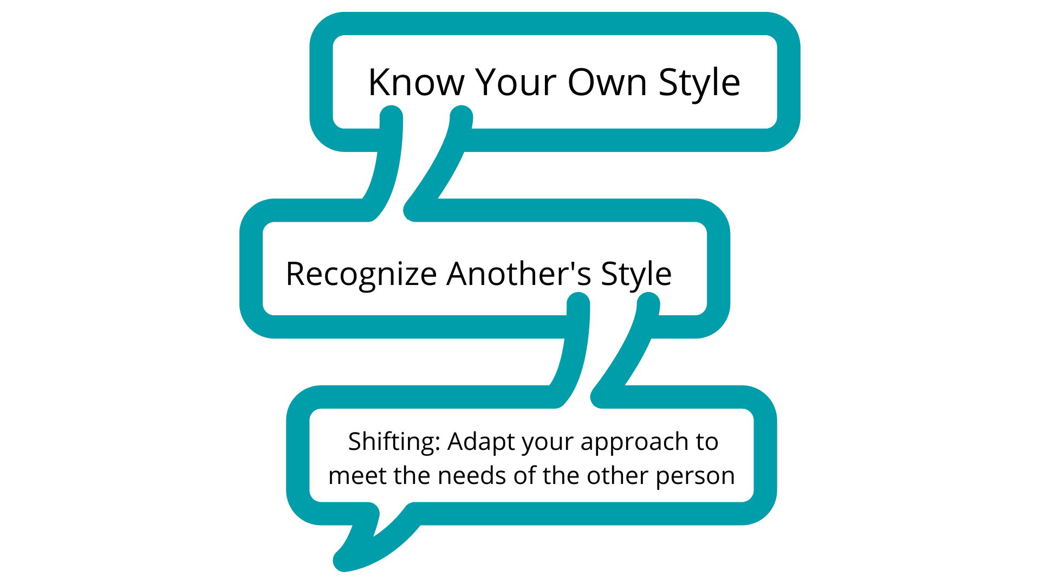
3 Steps to Style Shifting
Notes:
but what, what that looks like is first of all, we have to know, and, and our own style, then have some sense of what's the style of the other person, and then be willing to shift or adapt our approach to meet the needs.

Slide 29
Typical Shifts Needed
High D example:
Ask for opinions of others
Negotiate decision-making
Listen without interruptions
Adapt to time needs of others
Allow others to assume leadership more
Notes:
So the key then are there some ways to resolve that we would say, yes, all styles can work together, provided certain conditions, exist, mutual trust, mutual respect, and a willingness to, to adapt. So again, if we're spirit controlled, hopefully that would be what people would say about us. There's that sense of trust, respect, and we are willing to make some changes in our own behavior

Slide 30

Jesus Command and Modeling
"I give you a new command: Love one another. Just as I have loved you, you must also love one another.” John 13:34 (HCSB)
Jesus didn’t just command us to love one another. He also modeled His love for each individual He met.
For example, He treated Martha (D) very differently than her sister, Mary (S).
Notes:
And just to give you a couple of examples of that, first of all, he, he commanded that. So the last command he gave his disciples in John 1334 is to love one another, just as I have loved you, you must also love one another, but he didn't just command it.
Speaker 1: He modeled it. And there's so many examples in the new Testament, um, how he treated Martha who's a high D differently than her sister, Mary Mary, who was a high S or Peter the high eye differently than Paul. The high combination of both D and C, which is an interesting pattern that we'll talk a little bit more about.

Slide 31
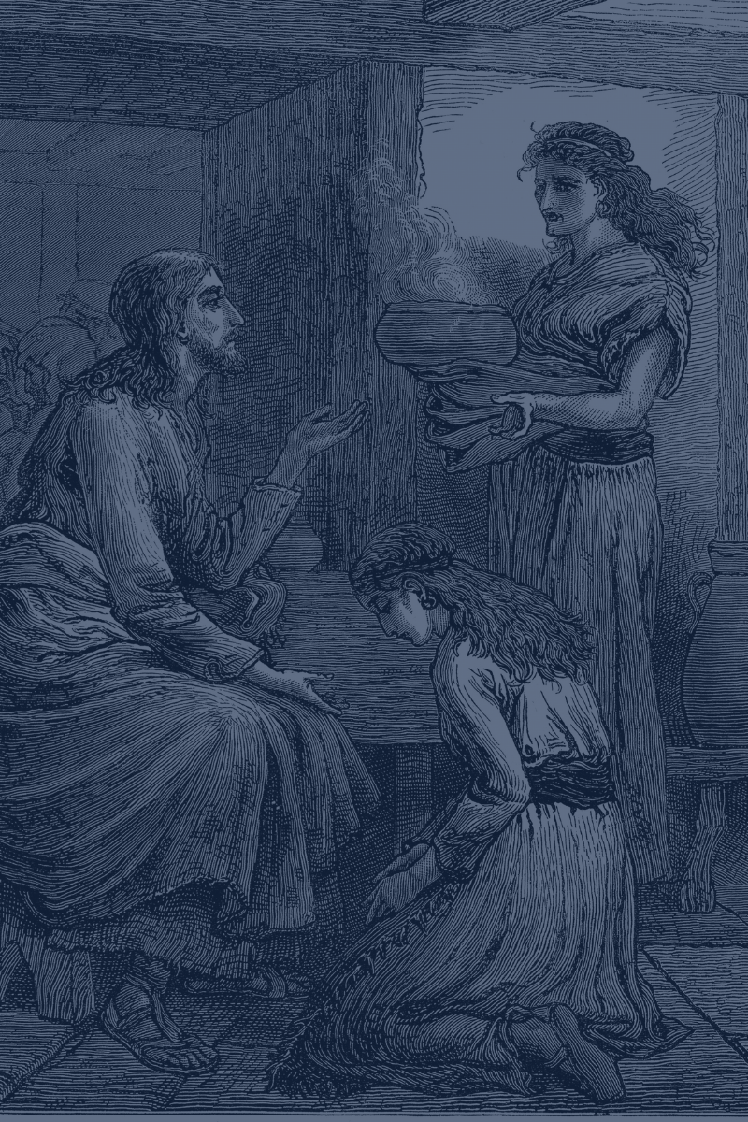
Jesus’ Example:
Martha and Mary
“Upon the death of Lazarus, Jesus went to Bethany. Both of
Lazarus’s sisters made the exact same statement to Jesus –
“Lord if you had been here my brother would not have died.”
- John 11:1-12
Jesus responded to them very differently:
To Martha (High D), with a direct response:
(“Believe in me - I am the resurrection and the life”.)
To Mary (High S), with empathy and compassion,
yet no words. (“Jesus wept.”)
And both were the correct responses based
on the sister’s unique behavioral styles.
Notes:
And, and here's just a quick example of how he did that notice with Mary and Martha, that story, um, when Lazarus died, of course, Jesus immediately when he didn't go immediately, did he first he waited cuz he wanted to show God's power. But after a couple of days, I think it says he went and Martha ran out to meet him. And he, you know, here's a, here's a direct dominant woman by the way, in that culture, that would've been exactly the wrong thing to do for a woman to run out to the city out of the city to meet a man. But she did it because she was so, uh, distraught about her brother. And she said, Lord, if you had been here, my brother would not have died.
Speaker 1: And the way Jesus spoke to her is it was in a very direct way. He gave her a direct response. Um, your brother will live again. She said, yes, I know Lord he'll live in the resurrection. And then he said, believe me, I am the resurrection in the life. So he gave her something to do an action to take if you will, which would be very appropriate for a D how to address a high dominant person. Whereas with Mary the high S he didn't use any words, but with empathy and compassion, scripture says Jesus wet, shortest verse scripture, just a beautiful example of how our Lord perfectly modeled for us. How do we handle people differently based on how he wired us and lots more examples. Of course, both of those were the correct responses based on that the sister's unique behavioral styles.

Slide 32
Golden Rule Amplified
Golden Rule: Do unto others as you would have them do unto you. Matt. 7:12
Do unto others as Jesus would do
unto them!
How? By modifying or adapting our behavior to meet the needs of the other person!
Notes:
And what I love about that first of all, is if you go to pages 32 and 33 of your assessment, which we won't take time to do today, you'll find wonderful information about how did Jesus modify his behavior all throughout scripture. Uh, Ken, our author has built in different scriptural passages that shows Jesus operating in the high D confronting the demons and casting them out, operating in the very low de being very submissive, obviously to the will of the father. And then similarly high, high, low eye highs, low S high sea. See. So interestingly he modeled it all perfectly. We're not surprised at that. Uh, he's our model and he wants us to do that, to love others more fully.

Slide 33
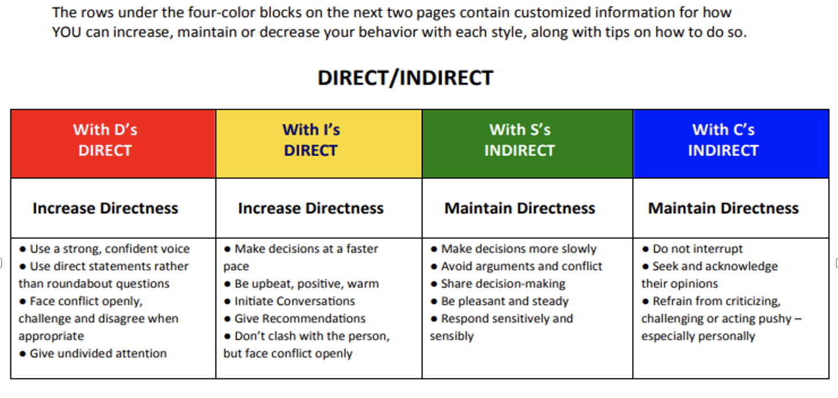

P. 38: How to Modify Your
Directness and Openness
Notes:
So we're gonna do a case study that gets us into understanding how can we modify our behavior. This is the biggest takeaway I think for today, what are some ways we can personally modify our behavior? We're now going back into your biblical disc assessment and I'm inviting you to pages 38 and 39.
Speaker 1: And this will now give you specific information that we're gonna look at in a case study of how to modify your behavior. So watch this basically what this is telling you is with, when you're interacting with de behavior, it's gonna give you exactly what you need to do. In other words, this line that I've circled here is your personal need to do with be in our order to be more effective with each of these. All right, for me, because I tend to be indirect. I need to be more direct with DS, more direct with eyes, but with SS and CS, I simply maintain. So you're gonna get words like increase, maintain, or decrease in all four of those categories on pages 38 and 39.

Slide 34
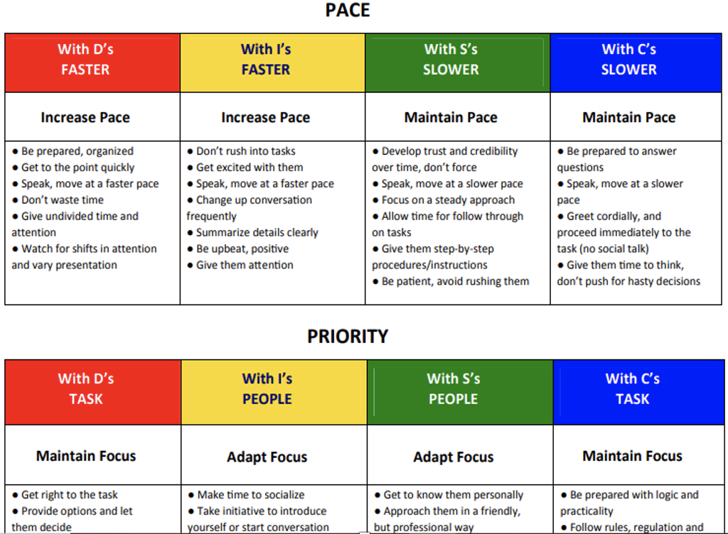
P. 39: How to Modify Pace and Priority

Slide 35
p. 24 – 3 R’s of
DISC Relationships
The Challenge of a Jesus Follower:
Quit trying to “fix” others!
Instead, learn to understand their style and
Respond to, Relate to, and Reinforce them
in a way that works for them – which means:
Modify your behavior to love them the way
Jesus would love them.
How Do We Do That?
Notes:
Well, as we bring this to a conclusion, uh, I think sometimes as followers of Jesus, we think it's our job to fix people. And we would say, no, we need to quit trying to fix others. Uh, instead what we need to learn to do is understand their style and then who relate to and reinforce them in a way that works for them.

Slide 36
p. 24
How to love
as Jesus loved
Notes:
And in your biblical disc assessment, page 24 is a fabulous page because it tells you specifically, how do you do that? How do you respond to relate to and reinforce notice all four of the styles. So you have your D in the upper left your eye in the upper, right, your S here and the C and the lower left. So it gives specific information for how to deal with people in those situations. And again, what we're really showing here is how do we love as Jesus loved?
How do we follow that command in John 13:34?

Slide 37
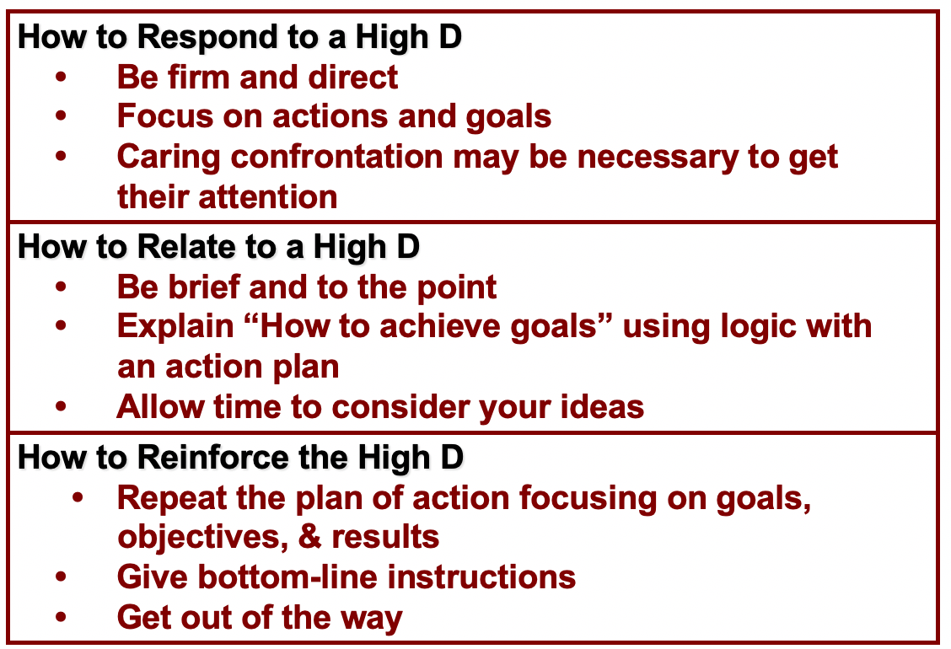
How to Love the High “D” Style
Example in Acts 9: the Lord confronting
Saul on the road to Damascus.
Notes:
I love this example from scripture with Saul. And if we think about Saul, very high D also had C behavior, but what did the Lord do with Saul in acts nine? Of course, we know the story on the road to Damascus, Paul's hit with a bright light. He falls to the ground, gets blinded. Would you say that's a pretty firm and direct way to respond to someone? The Lord gave him specific actions and goals going to the city. You'll meet a man. He'll tell you what to do. Um, we would call that caring confrontation and, and how did he relate to him? It was very brief. There was not a lot of detail about what to do. Here's the, you know, a couple things you need to do. He gave him ideas on how to achieve goals, and he gave him some time.
Speaker 1: He was blinded for three days. He had some time to think about this and consider all this. And then he reinforced him by repeating the plan of action, giving him bottom line instructions, and then basically got out of the way. And of course we know the apostle Paul became the great church planner of the new Testament, um, wonderful things that he did using the strength of that dominant style, not to go after Christians and imprison them, but to preach the gospel and win people over to Jesus Christ. So a wonderful story. Great example of how, again, the Lord perfectly did this.

Slide 38
By What Power Do We Do This?
In Acts 4, when Peter and John healed the
lame man, the rulers began to inquire:
“By what power, or in what name, have you done this?
Then Peter, _____ ____ ____ _____ ____ said to them, … “
Then Peter, filled with the Holy Spirit said to them, … "
Acts 4:7-12
Transformation begins when we submit to Jesus and are filled with the power of the Holy Spirit! Then we can truly love others as Jesus loves us… and just get along!!
Notes:
So one of the things we'd like to do is have us think about what is the power by which we do this. And there's a great example in acts four, Peter and John of course healed the layman and the rulers had a question. They said, by what power or in what name have you done this, I'm gonna ask you to text chat. The fill-ins here. There's five words in the NIV that come next in this verse and the first person to do that will win a free biblical disc assessment. So what five words, don't say it, text chat it. And if I can ask Kim and Barbara to be looking for who does it first
Speaker 1: All right. Way to go, Jill. Yes. The words are filled with the holy spirit. So again, remember earlier we talked about biblical characters that in the flesh, obviously lots of our weaknesses and limitations show up, but when we're operating in the power of the holy spirit, that's when power come. That's when we can honor God by bringing the best of who we are, as we submit to him. And that's what we say is that transformation begins when we submit to Jesus and are filled with the power of the holy spirit, and we can truly love others as Jesus loves us and just get along.

Slide 39
THE PROBLEM?
85% of employees deal with conflict
29% say they deal with it constantly
27% have seen conflict lead to personal attacks
25% have seen conflict lead to illness/absence
AND … 49% of conflict is a result of
personality clashes and “warring egos”
*CPP Human Capital Report
Notes:
and conflict just seems to be one of the big ones. And, um, this is fascinating information from consulting psychology, just press in their human capital report. A couple of years ago, a survey of several thousand people, 85% say they deal with conflict. 29% deal with it. Constantly 27% have seen it lead to personal attacks. And 25% say conflict has led to their illness or absence in the workplace. And what really fascinated me about this is that nearly 49% of conflict, at least according to this study is a result of personality, clashes and waring egos. And that's our topic for today because disk is a great tool model to look at personality, we call it behavioral style.
Speaker 1: We're not gonna dig deep into your psyche today with personality, which goes deeper, but what are your observable behaviors and what causes those waring egos from time to time, just because we do things differently because we're wired differently.

Slide 40
The Best Solutions
Understanding style and adapting your behavior to meet each other’s needs will make a BIG difference in relationships and results at work and at home.
However the BEST solution:
Call on the Power of the Holy Spirit!
Notes:
We would suggest. First of all, that as humans, our job is to try and understand first our style and other style, and then adapt our behavior to meet their needs. That's gonna make a big difference in the results. We get the relationships we develop both at working at home, and yet the best solution is to call on the power of the holy spirit.

Slide 41
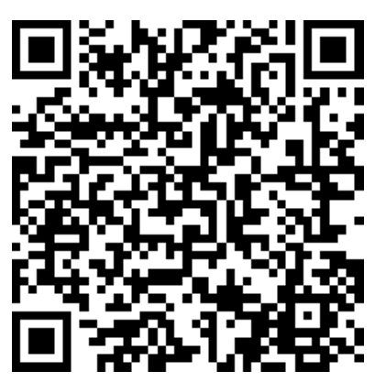
Feedback Please!

Slide 42
Further Development
Individual Action Plan:
On your own time, complete page 44 of your DISC assessment, and discuss your action plan with several others. If possible, meet with your team members and discuss your results.
Team Action Plan: (See page 6 of your handout.)
Minimally, complete # 1 – a team session where you can discuss the results of your DISC assessment scores.
Consider further development by engaging in the activities of #’s 2-4 on page 6.
Additional resources at: LeadLikeJesus.com
Notes:
Well, this has been a joy for us to be a part of this. We wanna just for several things, as we wrap up here in the next few minutes, page 44 of your biblical disc assessment is an action plan. And we all know, uh, not to be just hearers of the word, but also do. So. I invite you on page 44 to fill in that information specifically, as you think about today, what can I do to modify my behavior, to meet the needs of the different styles, vis or C. And there's some other things there that talk about how to overcome pride and fear, uh, that will help you as you fill that in. And this would be a great place to meet with team members again, and just talk about what did you learn? How can we apply this at work? How can we get better results and develop better relationships?
Speaker 1: We also encourage you. If you look at page six of your handout, just to consider this team action plan a minimal, we complete number one, where you get together again as a team or with colleagues, and just share some of the information. We give you a few bullet points there of some things you might do. We also suggest some additional things. Two through four here. We might have, uh, team members if they haven't completed the biblical desk assessment, do that. And we'd love to do a group do debrief with you. Um, we also do individual debriefs if you'd be interested in personal coaching. Uh, there's also some additional things at Levi, like Jesus Bible studies, our leadership academy, some additional information there, all of which would be available on our lead like Jesus website. And so we are just delight that you have, uh, joined us. Uh, I'm gonna ask for someone if you would be willing to end our time and prayer, and then we're gonna hang on a few minutes. If you have questions, comments, uh, anything that you'd like to share.

Slide 43


Notes:
OPTIONAL Slide – to remind participants ultimate mission and purpose at LLJ

