Slide 1
What is DISC?
D
I
S
C

Slide 2
Motivation
DISC is…
Behavior
Emotion
All About Communicating with Style
Notes:
We use DISC to identify and discuss behavioral tendencies and learn practical ways to communicate more effectively with others. DISC cultivates healthy relationships and minimizes personality-driven conflict at home and work.
Biblical DISC is a "key" to unlock a "treasure chest" of self-awareness and wisdom for building and maintaining Jesus-centered relationships. The DISC model measures our motivation for meeting our needs. DISC reveals your unique God-given strengths which creates: Energy, Engagement, and Commitment. Knowing your unique behavioral style builds self-awareness, develops emotional intelligence. And is vital to creating effective communication skills, positive relationships and organizational success.

Slide 3
Intelligence
DISC is not…
Skills
Education
Experience
Values
Notes:
DISC assessments have nothing to do with intelligence, skills, education, experience, or values. The DISC model creates “people-smarts” by helping individuals understand the language of DISC to build Jesus-centered personal and professional relationships.

Slide 4
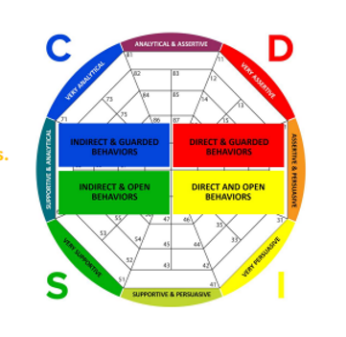
The Four Behavioral Styles Measured by DISC:
Dominance Style is Direct, Guarded and Task-Oriented
Influencing Style is Direct, Open and People-Oriented
Steadiness Style is Indirect, Open and People-Oriented
Conscientious Style is Indirect, Guarded and Task-Oriented
Notes:
In this diagram we see how the styles differ in their priority, openness and orientation.

Slide 5
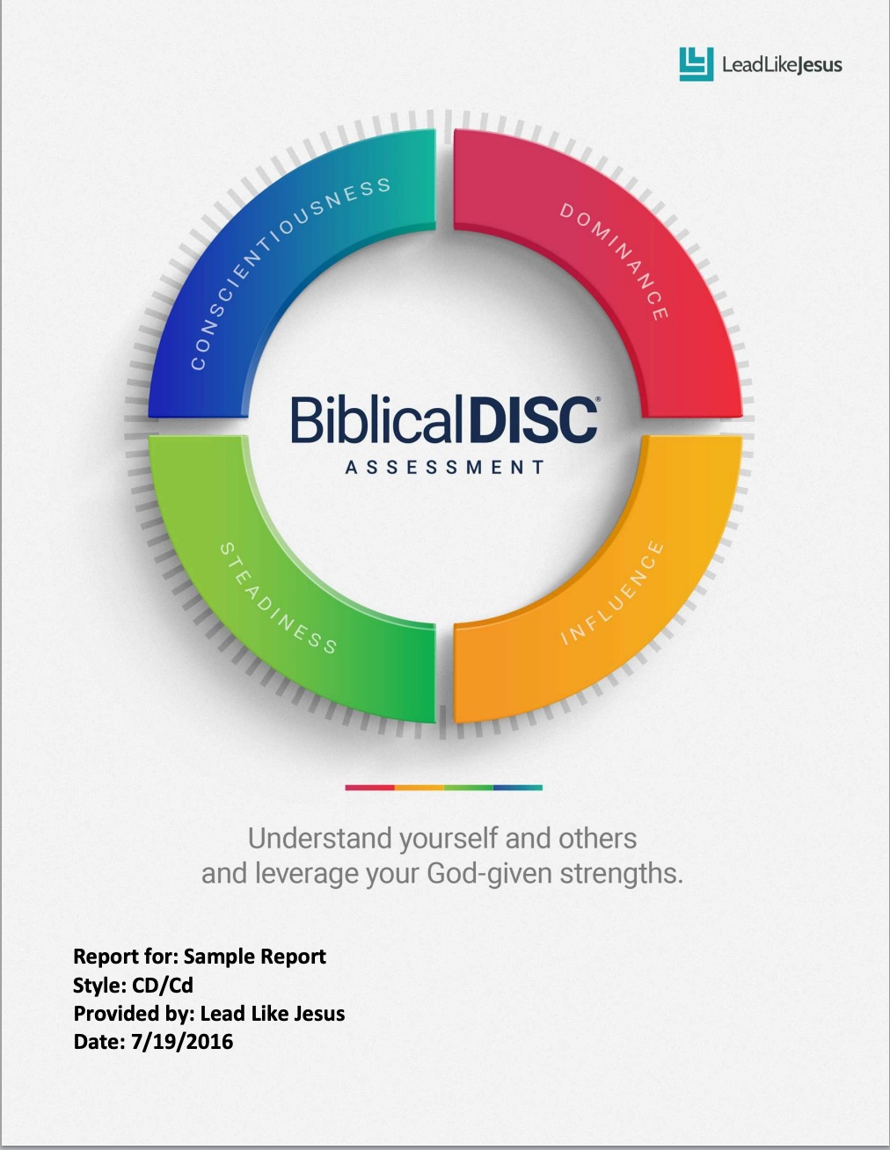
Biblical DISC® establishes the foundation for building the loving relationships that Jesus envisioned for us
Notes:
Biblical DISC is a useful tool to gain new insights into your behavior and the behavior of others. Biblical DISC® uses both research and Biblical truth to help answer why we are so different, what's so special about those differences, and how accurate self-awareness and a true understanding of others will help solve conflict, build effective teams, foster positive family dynamics and create strong personal and professional relationships

Slide 6
DISC is…
Adaptability
Notes:
As we become more aware of our DISC behavioral style we learn the key ingredient to effective communication - ADAPTABILITY. The more I understand about myself, the more I can understand my strengths and limitations. The more I learn about others, the more I can learn to ADAPT to them to have a deeper- lasting relationship. I learn how to communicate, how to work together, how to resolve conflict, and just overall how to successfully relate to others. That is important at home, work, church, school, and play!

Slide 7
Golden Rule
“Do unto others as you would have them do to you.”
Notes:
The Bible teaches us the Golden Rule. (Recite) Important rule to live by. Golden Rule, precept in the Gospel of Matthew (7:12): “In everything, do to others what you would have them do to you. . . .” This rule of conduct is a summary of the Christian's duty to his neighbor and states a fundamental ethical principle.

Slide 8
Platinum Rule®
“Treat others the way THEY want to be treated.”
Notes:
The Platinum Rule teaches us that to have deeper relationships we need to treat others the way they want to be treated. Discover how THEY want to be treated and ADAPT to THEIR style! As a result, professional and personal relationships strengthen, collaboration increases, and everyone's productivity improves. Also, when employees and leaders take the time to understand each other’s behavioral style and communication needs, misunderstandings are less likely to occur, and people feel more included and valued.

Slide 9
C
D
S
I
Notes:
The DISC model create a common language. DISC creates “people-smarts” by helping individuals understand the language of DISC to build Jesus-centered personal and professional relationships. Let’s learn more specifically about each D,I,S,C style

Slide 10
Dominance Style Solves Problems & Likes Challenges
Notes:
The D is the Dominance Style. If someone is a “high d” then they spend more than 50% of their time focused on problems and challenges. Here are some descriptive words we use to describe these Ds – Risk-taker, forceful, decisive, direct, self-reliant, competitive.
We usually associate an EAGLE or lion with the high D. They dominant their environment, are determined, and strong in their approach.
Goal: control, immediate BOLD results – they want to stand out
Fear: LOSS of control; manipulation – will come out fighting if cornered
Motivated by: challenges and PROGRESS – it is about accomplishment
Strengths: Risk takers, forceful, problem solvers, self-assured – they don’t mind saying NO. If say yes, they usually delegate which in their mind is them doing it.
Under pressure: Lack of CONCERN for other’s feelings; impatient – always looking to the task;
When communicating with the Dominance style be brief and to the point. Focus on actions and goals.

Slide 11
Influencing Style People Oriented & Encourages Others
Notes:
The I is Influencing Style. At least 50% or more of their time is centered around People & Contacts. Here are some descriptive words: influential, sociable, optimistic, trusting, friendly, enthusiastic. Life of the party!
The animal we think of with an I is the OTTER. If you go to zoo today to see the otter exhibit, what do you see? More than one otter, playing, sliding, swimming, chasing each other, touching each other, right?! Everyone loves the otters! Well, maybe not everyone….
Goal: Building RELATIONSHIPS; approval – like to be liked!
Fear: Rejection; being BLAMED
Motivated by: POSITIVITY; experience – like to try new things; they FEEL stuff
Strengths: Optimistic, appreciative, fun, inclusive
Under pressure: Impulsive; lack of FOLLOW THROUGH – say “yes” to too many things
When communicating with the Influencing style be friendly and positive. Allow time for socializing.

Slide 12
Steadiness Style Good Listener &Team Player
Notes:
The S is Steadiness Style. They are Good Listeners and Team Players. The S is comfortable with the status quo. Happy with the way things are right now. Here are some words to describe the S: calming, loyal, relaxed, steady, consistent, patient.
The word picture animal for S is the GOLDEN RETRIEVER. What is something you know about a golden retriever? Loyal, stays close to the owner, wants to please, willing (obedient)
Goal: Harmony; Stability
Fear: Sudden UNPLANNED changes; ambiguity – don’t like a blank page
Motivated by: Maintenance of the status quo; HELPING others – use “we” more than “I” They have a hard time saying “no” and if they say “yes” they will stay up all night to fulfill promise!
Strengths: Good listener; team player, loyal, patient
Under pressure: Indirect; IGNORES own needs – indecisive
When communicating with the Steadiness style be non-threatening and patient. Give time to process information and adjust to change.

Slide 13
Conscientious Style Diplomatic & Fact Finders
Notes:
C – Conscientious Style. The C Style is all about being Diplomatic and Fact Finders. More than 50% of their energy is focused on each, fact-finding, checking the rules, and following them. Descriptive words are: courteous, focused, systematic, precise, objective, perfectionist.
The animal representative is the BEAVER. What do you know about beavers? Busy, dam is never done, always working on the dam, gathers all the supplies, adjusts, patches. Yes, Cs are focused on their work. It is always in need of just a little more. A bit more data, A bit more work.
Goal: Accuracy and QUALITY – “if it’s worth doing, it’s worth doing right!”
Fear: Criticism of their WORK; making a mistake
Motivated by: Being CORRECT and data
Strengths: Analytical, diplomatic, systematic, logical – they will analyze before saying “yes/no”. If yes, then dependable.
Under pressure: Overly critical of self and others; may appear ALOOF – high standards for self & others
When communicating with the Conscientious style be specific and accurate. Allow freedom to ask questions and validate information.

Slide 14
Titanium Rule
“Do unto others as Jesus would do unto them.”
Notes:
Remember the Platinum rule – treat others the way they want to be treated.
Now learn the Titanium Rule “do unto others as Jesus would do unto them.” Jesus commanded us to love one another as He loved us. - John 13:34.
Biblical DISC establishes the foundation for developing the loving relationships that Jesus envisioned for us.
God’s Word is always the final authority on all matters in dealing with people and their behavior.

