Slide 1


Slide 2

Personality Traits
Personality Traits
From your five cards, discard two cards
that are least like you by placing them
in the middle of the table.
With your three cards, trade cards with other participants in your group if you’d like –
one for one.

Slide 3
Personality Traits
Personality Traits
Move about the room and trade cards with other participants – one for one, if you’d like.
Then, review cards that others discarded.
If you find a better description, pick up
the new card and discard one.

Slide 4
Personality Traits
Sharing Time
You should now have three cards that contain adjectives that are very descriptive of you.
Take 45 seconds each and share with your small group: “How do these personal characteristics help you be successful in your ____(team or ministry) role_____.

Slide 6
Personality Traits
Learning outcomes (H.O. p 2)
Discover the DISC Model of human behavior
Identify your strengths and giftedness
Identify the strengths and giftedness of others
Recognize how you need others to complete you
Discover the importance of adaptability and using the Platinum Rule and the Titanium Rule
Improve team relationships, communication and performance

Slide 7
Personality Traits
Important Points (H.O. p 2)
!
  There is no “best” style” - all have value.
  Style is influenced by other factors - values, life experiences, and maturity.
  Key to effectiveness = understanding your style.
  A second key = learning others’ style.
  A third key = learning to adapt your behavior.
  God’s Word = final authority in dealing with
  people and their behavior.

Slide 8

Personality Traits
Best book in Understanding
Behavior & relationships
DISC = A Model OF Human Behavior
Jesus = The Model FOR Human Behavior

Slide 9

Historical Perspective of DISC
400B.C.
Hippocrates theorized about “humors”
Choleric (yellow bile), Sanguine (blood), Phlegmatic (phlegm), Melancholic (black bile)
(Tim LaHaye and Florence Littauer would later use these terms to classify behavior)
1920s
Carl Jung: “Psychological Types” book
Intuitor, Thinker, Feeler, Sensor

Slide 10
Historical Perspective of DISC
William Marston writes and publishes the first DISC book: “The Emotions of Normal People”
1928
Myers & Briggs: MBTI published
John Geier published DISC assessment
1950s
1970s
Tony Alessandra’s Platinum Rule
1980s
Ken Voges’ correlates Biblical characters to DISC, creates profile

Slide 11
Historical Perspective of DISC
1990s
Ken Voges begins teaching Biblical DISC in DMin program at Dallas Theological Seminary
Moody Press/Ken Voges publish “Discovering the Beh. Styles of Jesus”
2000s
2016
Lead Like Jesus and Ken Voges publish the Biblical DISC Assess-ment, and start certifications

Slide 13
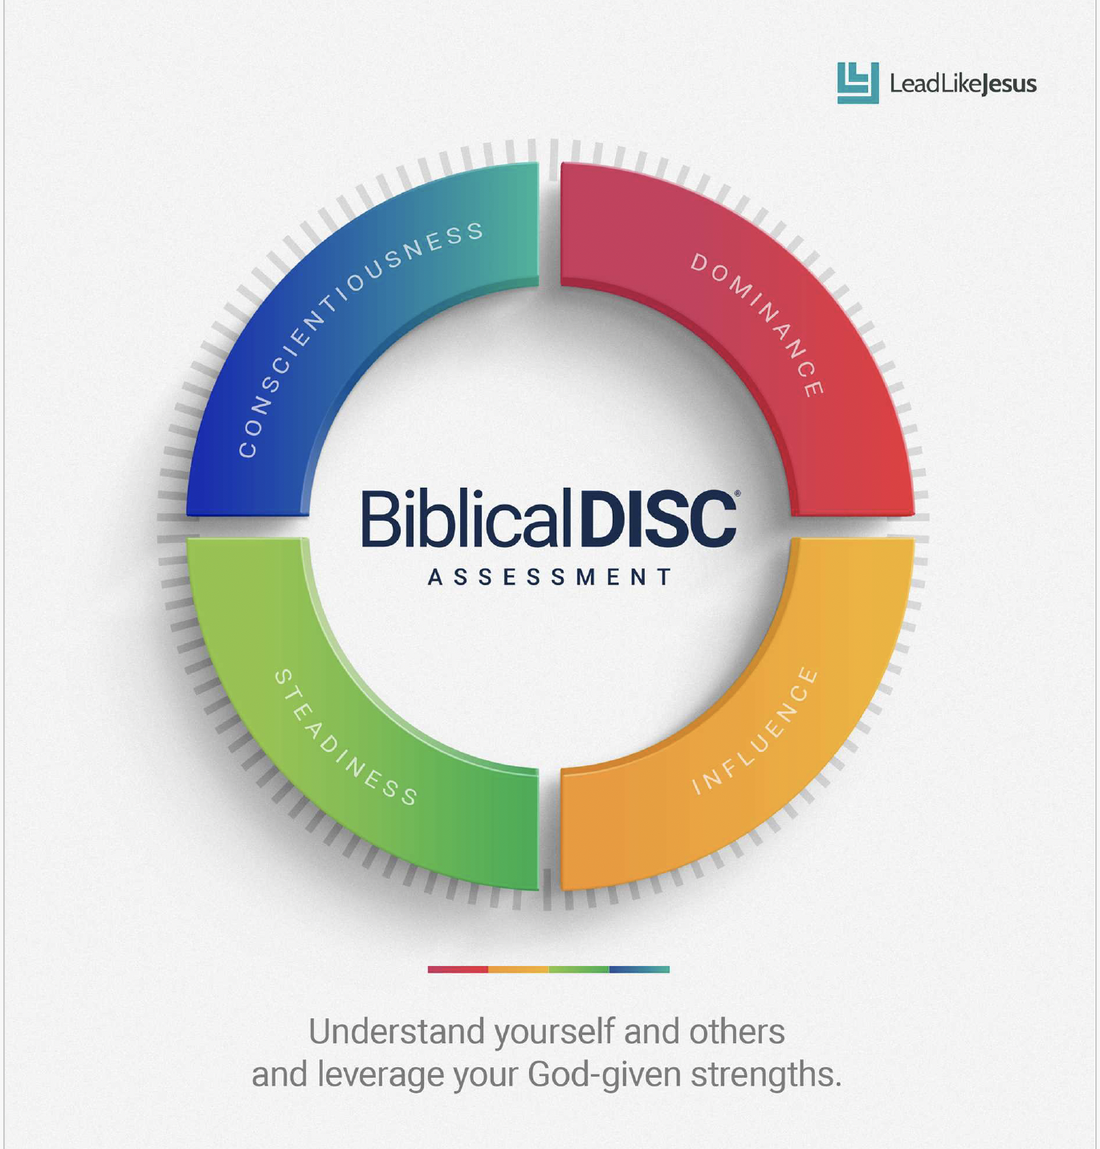
Personality Traits
Your Biblical DISC® Report

Slide 14
Personality Traits
P. 4 – Understanding DISC
Listed Below are Behavioral Descriptors of Each Style
DOMINANCE | INFLUENCING | STEADINESS | CONSCIENTIOUS
Decisive | Charming | Understanding | Accurate
Competitive | Confident | Friendly | Precise
Daring | Convincing | Good Listener | Analytical

Slide 15
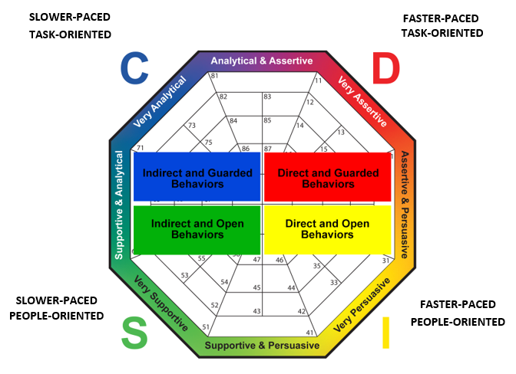
Personality Traits
Pp. 4/5 – DISC “Pace/Priority” Model

Slide 16
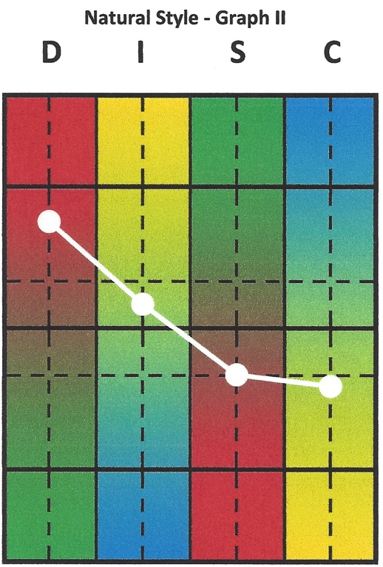
Personality Traits
PP. 6 – Natural Behavior
Most true and accurate you: your sweet spot

Slide 17
Personality Traits
P. 8 – Overview of DISC Styles
 | HIGH D DOMINANCE STYLE |  | HIGH I INFLUENCING STYLE |  | HIGH S STEADINESS STYLE |  | HIGH C CONSCIENTIOUS STYLE
Primary Drive | Independence |  | Interaction |  | Stability |  | Correctness
Preferred tasks | Challenging |  | People related |  | Scheduled |  | Structured
Comfortable with | Being decisive |  | Social friendliness |  | Being part of a team |  | Order and planning
Personal strength | Problem solver |  | Encourager |  | Supporter |  | Organizer
Strength out of control | Preoccupation on goals over people |  | Speaking without thinking |  | Procrastination in addressing change |  | Over analyzing everything
Personal limitation | Too direct and intense |  | Too disorganized and nontraditional |  | Too indecisive and indirect |  | Too detailed and impersonal
Personal wants | Control, Variety |  | Approval, Non-structure |  | Routine, Harmony |  | Standards, Logic
Personal Fears | Losing, Being taken advantage of |  | Rejection, Rigid structure |  | Change, Confrontation |  | Criticism, Illogical thinking
Blind spots | Being held accountable |  | Follow through on commitments |  | Embracing need for change |  | Making decisions without analysis
Needs to work on | Empathy, Patience |  | Controlling emotions |  | Being assertive when pressured |  | Worrying less about everything
Measuring Maturity | Giving up control |  | Objectively handling rejection |  | Standing up for self when confronted |  | Not being defensive when criticized

Slide 18
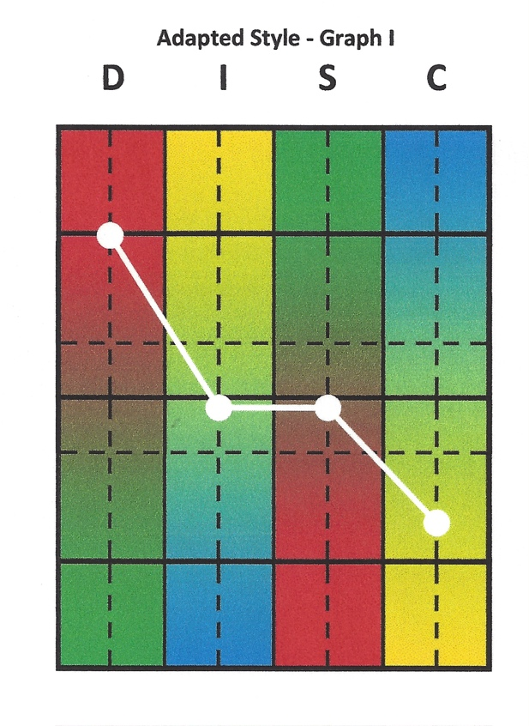
Personality Traits
P. 7 – Adapted Behavior
What you believe you should be like: environment

Slide 19
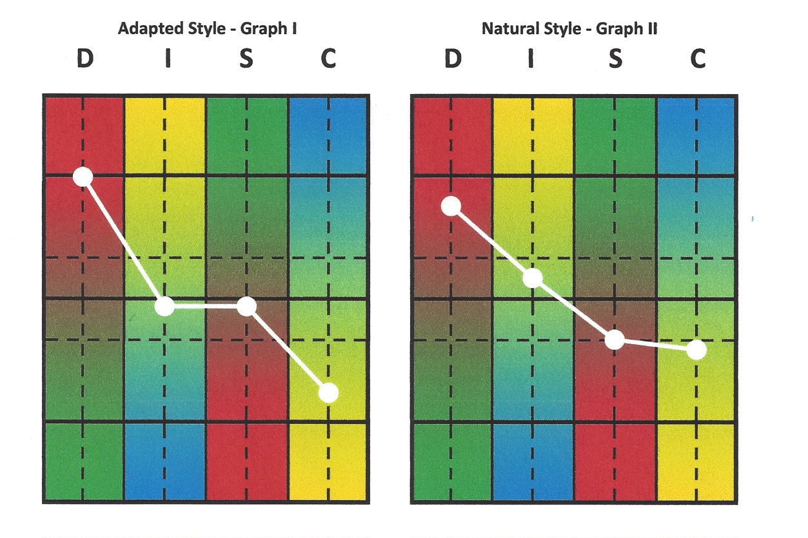
Personality Traits
P. 7 – Adapted vs. Natural

Slide 20
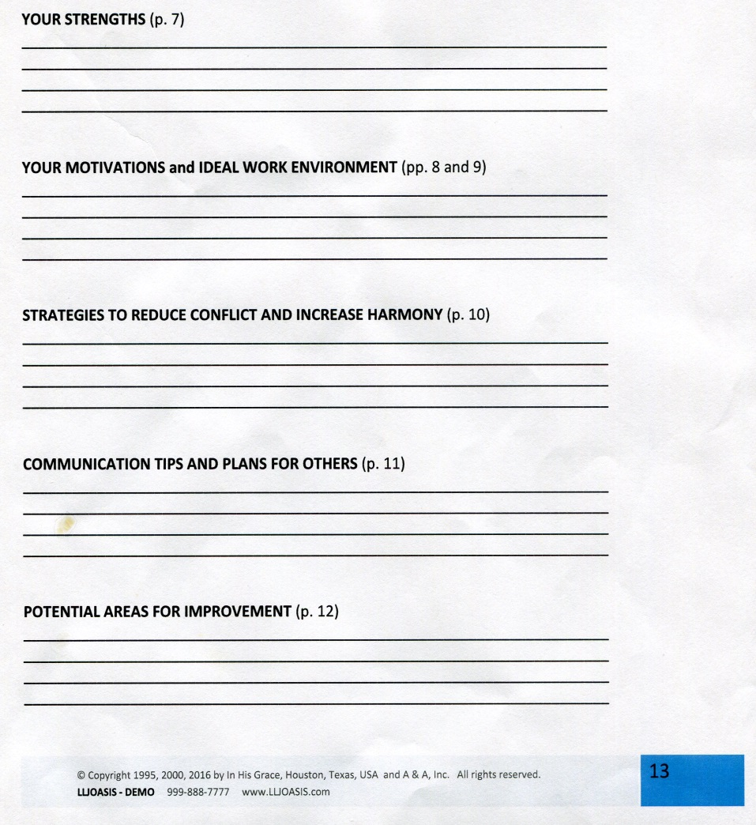
Personality Traits
Assignment
Complete page 16 of DISC Report

Slide 21
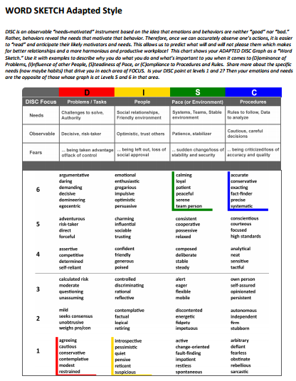
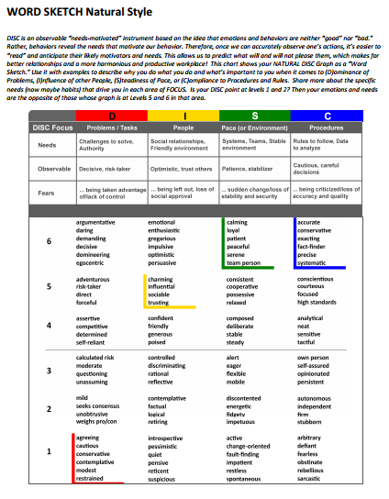
Personality Traits
PP. 18-19 DISC Behavioral Continuums

Slide 23
Personality Traits
Johari Window (H.O. p 3)
 | Known to Self | Not Known to Self
Known to Others | Public | Blind
Not Known to Others | Hidden | Potential

Slide 24
Personality Traits
Two key ideas behind the tool:
Self Disclosure: Individuals can build trust between themselves by disclosing information about themselves.
Feedback: They can learn about self and come to terms with personal issues with the help of feedback from others.

Slide 25
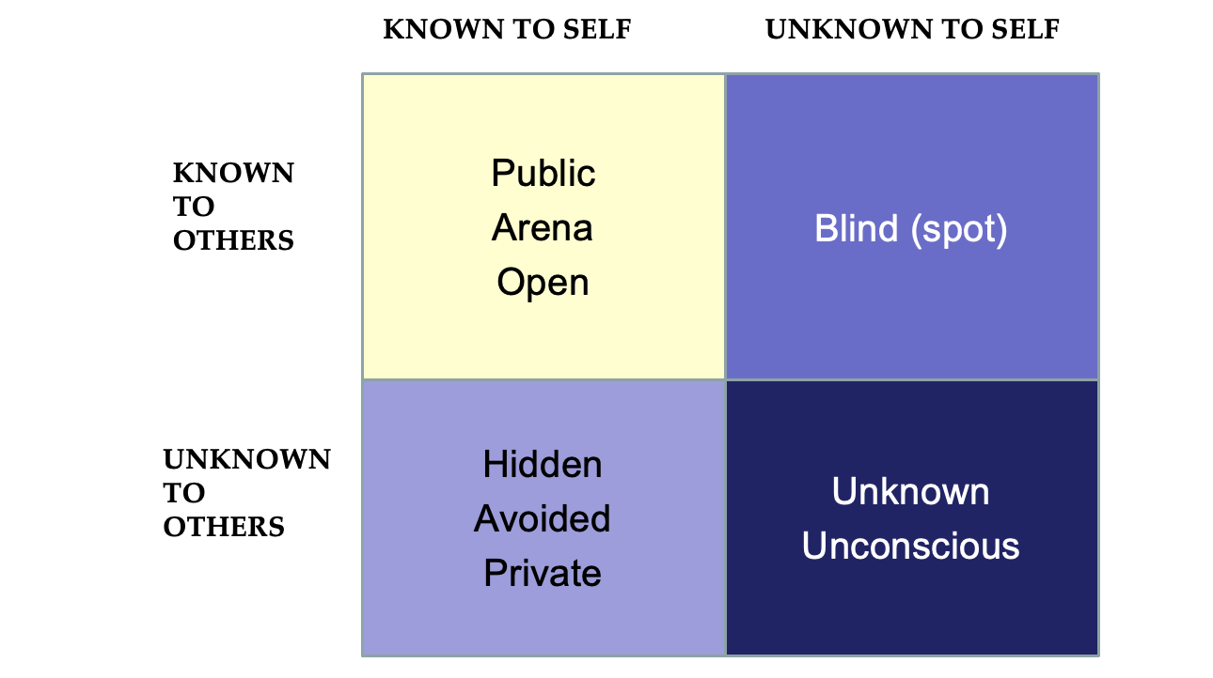
Personality Traits
JOHARI Window:
Interpersonal Communications Model

Slide 26
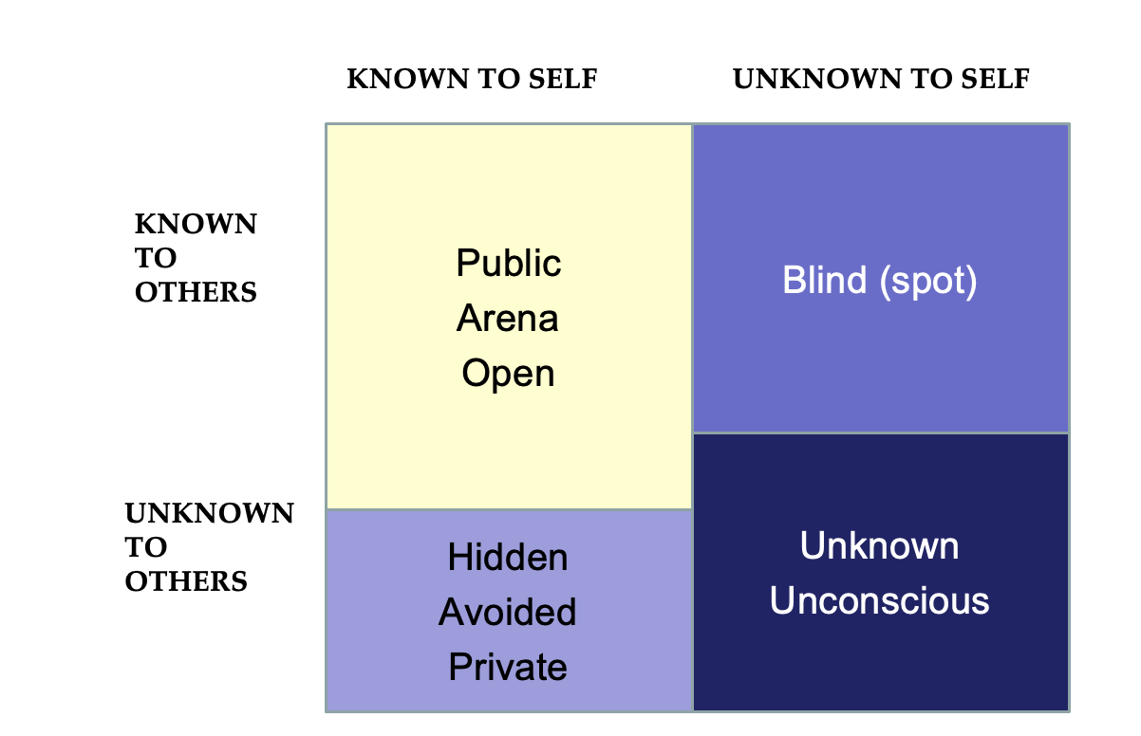
Personality Traits
When You Share or Self-Disclose:

Slide 27
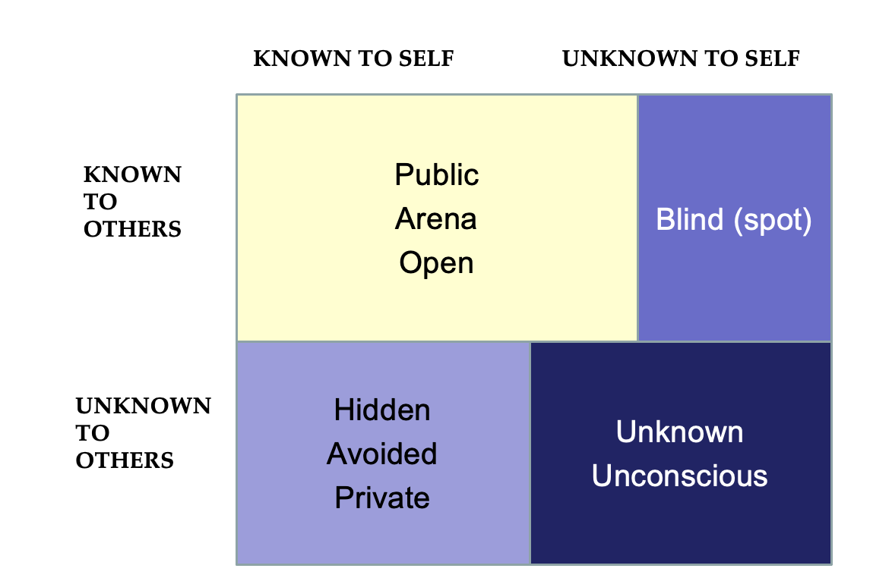
Personality Traits
When You Solicit or Receive Feedback:

Slide 28
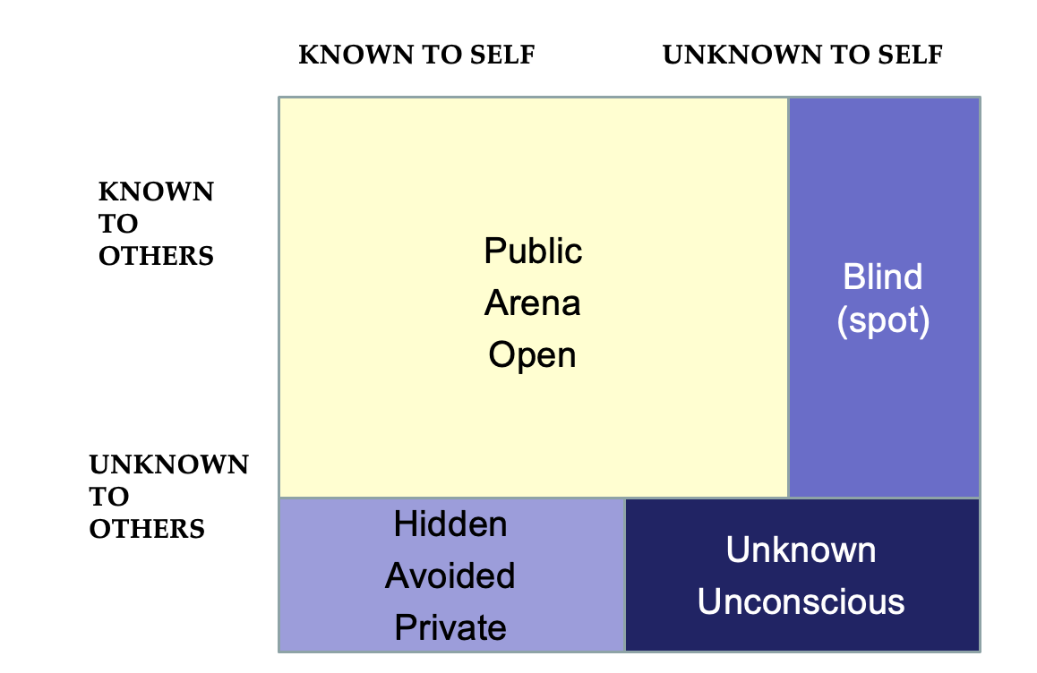
Personality Traits
When You Receive Feedback AND Self-Disclose:

Slide 30
Personality Traits
DISC = Common Language
Shared Language
Non-threatening
Non-judgmental
Safe for everyone to use

Slide 31
Personality Traits
Dr. William Marston
“Emotions of Normal People”
  Published in 1928
  Interested in emotions evoked as people interact with environment
  Identified four “primary emotions” = D, I, S, C
  Believed understanding “normal” emotions would help people lead happier lives
  Marston’s research is the foundation for the DISC model

Slide 32
Classic DISC Model (H.O. p 4)
Perceives unfavorable environment – so is Guarded and Questioning
C-Conscientious
D-Dominance
Perceives less control, so integrates with an Indirect Approach
Perceives more control, so initiates action with a Direct Approach
S-Steadiness
I-Influencing
Perceives favorable environment – so is Open and Accepting
Notes:
In this model, we can see how it was all integrated and made alive with bringing together theory and explanation.
Explain each DiSC style:
D: D’s see the environment and ask what is it that I can change, move, alter, control?
I: I’s have a high social need, high need for affiliation, loves people, likes to socialize and gets their energy from others.
Marston had a theory – never developed an instrument

Slide 34
    Dominance – High “D” (H.O p 5)
Goal: Control; Immediate BOLD results
Fear: Loss of control; being manipulated
Motivated by: Challenges and progress
Strengths: Risk takers, forceful, problem solvers, self assured
Pride: Always being influence point in decisions
Under pressure: Lack of concern for other’s feelings; impatience

Slide 35
DISC Blends & Presidents of USA
DISC BLENDS Presidents of the United States
D – [Producer] Donald Trump, Lyndon Johnson
D/I - [Result-Driven] Andrew Jackson, George W. Bush, (#43)
D=I- [Dynamo] Franklin D. Roosevelt, Barack Obama
D/C – [Explorer] Harry Truman, Hillary Clinton*
I – [Networker] Bill Clinton
I/D – [Influencer] Ronald Reagan
I/S – [Coach] Dwight Eisenhower
I/C – [Assessor] John F Kennedy
S or S/C – [Planner] Gerald Ford
S/D- [Finisher] Ulysses S Grant
S/I- [Harmonizer] Abraham Lincoln
S/C/D – [Examiner, Validator] George H. W. Bush (#41)
C – [Fact Finder] Calvin Coolidge
C/D/S– [Formalist] Richard Nixon
C/S/I – [Technician] Woodrow Wilson, Jimmy Carter
C=S - [Diplomat] Thomas Jefferson
* Presidential candidate in 2016

Slide 36
DISC Blends & WW II Generals & Admirals
DISC BLENDS (G) Generals, (A) Admirals
D – [Producer] (G) Bernard Montgomery
D/I - [Result-Driven] (G) George S. Patton Jr.
D=I - [Dynamo] (G) Douglas MacArthur
D/C – [Explorer] (A) Ernest King
I – [Networker] (A) John McCain
I/D – [Influencer] (A) William “Bull” Halsey
I/S - [Coach, Encourager] (G) Dwight Eisenhower
I/C - [Assessor] (A) Arleigh “31 knot” Burke
S or S/C – [Planner] (A) Raymond Spruance
S/D/C- [Finisher] (A) Marc “Pete” Mitscher
S/I - [Harmonizer] (A) Chester Nimitz
S/C/D – [Examiner, Validator] (G) George C Marshall
S/I/C – [Practitioner] (G) Harold Alexander
C or C/S – [Fact Finder] (G) Omar Nelson Bradley
C/D/S – [Formalist] (G) Walter Bedell Smith
C/D – [Technician] (G) Alan Brooke
C=S - [Diplomat] (G) Freddie de Guingand

Slide 37
Popular Models – Charlie Brown
Lucy D
Sally I
Charlie S
Schroeder C

Slide 38
P. 30 DISC Blends & Biblical Characters
DISC BLENDS BIBLICAL CHARACTERS
Primary D – [Producer] SOLOMON, RAHAB*
D/I – [Result-Driven] JOSHUA, SARAH
D=I - [Dynamo] APOLLOS, STEPHEN, LYDIA*
D/C or C/D – [Explorer] PAUL, MICHAL*
Primary I – [Networker] AARON, KING SAUL
I/D – [Influencer] PETER, REBEKAH
I/S – [Coach] BARNABAS, ABIGAIL
I/C – [Assessor] DAVID, MARY MAGDALENE*
Primary S or S/C – [Planner] ISSAC, DORCAS*
S/D - [Finisher] NEHEMIAH, MARTHA
S/I - [Harmonizer] ABRAHAM, HANNAH
S/C/D – [Examiner] JACOB, JAMES [ACTS 15], ANNA*
Primary C or C/S –[Fact Finder] LUKE, ESTHER
C/S/D – [Formalist] MOSES, THOMAS, NAOMI*
C/S/I – [Technician] ELIJAH, DEBORAH*, RUTH*
C = S – [Diplomat] JOHN, MARY (mother of Jesus)

Slide 39
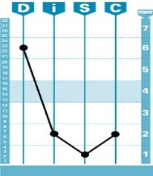
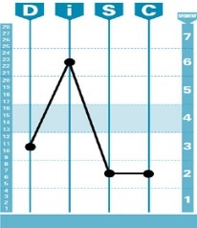
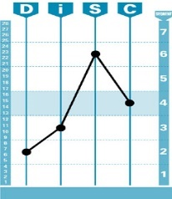
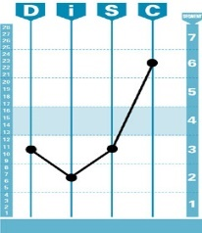
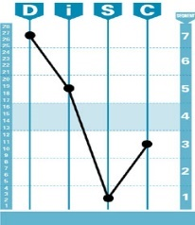
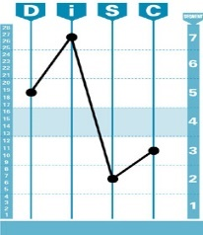
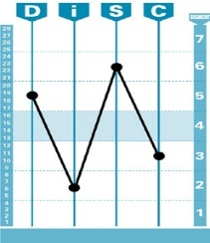
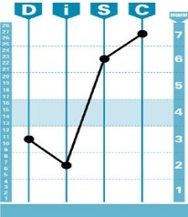
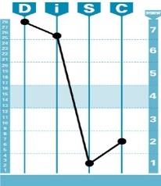
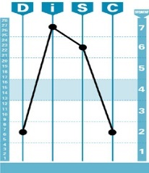
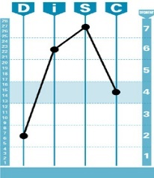
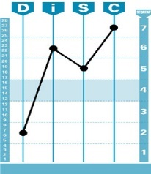
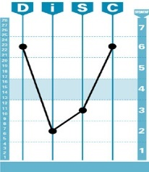
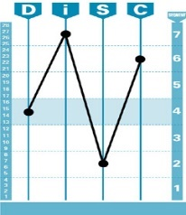
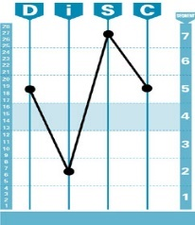

16 Behavioral Pattern Blends
D I S C
Producer
Networker
Planner
Fact Finder
Results-Driven
Influencer
Finisher
Formalist
Dynamo
Coach
Harmonizer
Technician
Explorer
Assessor
Examiner
Diplomat

Slide 40
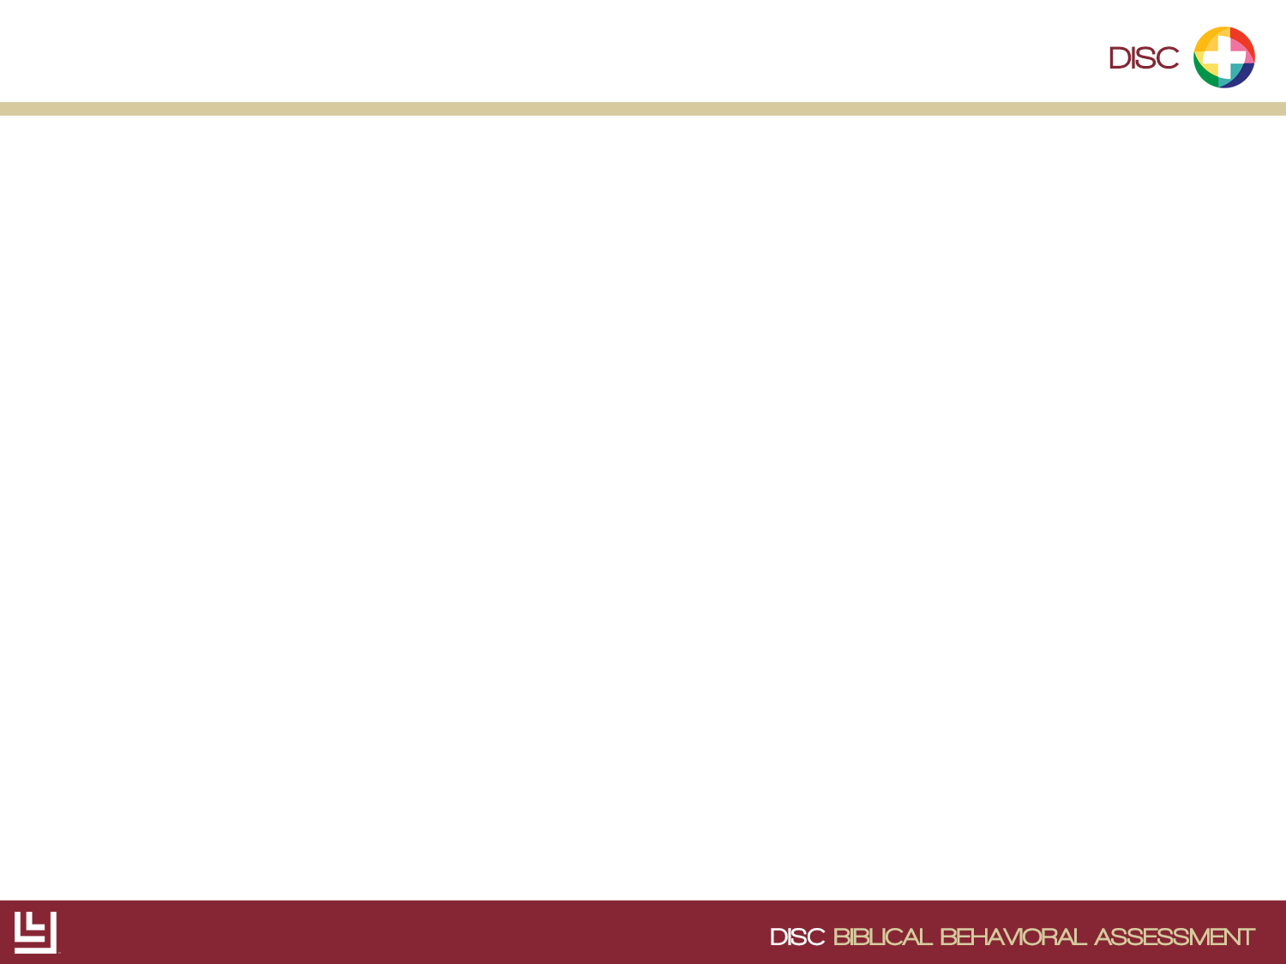
Biblical DISC Male Characters
Luke, Moses, Elijah, John
Solomon, Joshua, Stephen, Paul
Isaac, Joseph, Abraham, James
Aaron, Peter, Barnabas, David

Slide 41
Biblical DISC Female Characters
Esther, Naomi, Ruth, Mary
(mother of Jesus)
Rahab, Sarah, Lydia, Michal
Dorcas, Martha, Hannah, Anna,
Rebekah, Abigail, Miriam

Slide 42
Style Specialties
Which style would claim this Specialty:
D
Get it Done
D
I
Get it Noticed
I
S
Get Along
S
C
Get it Right
C

Slide 43
    Influencing – High “I” (H.O. p 5)
Goal: Building relationships; approval
Fear: Rejection; being blamed
Motivated by: Positive experiences
Strengths: Optimistic, appreciative, fun, inclusive
Pride: Relationships with approval/affirmation
Under pressure: Impulsive, lack of follow through

Slide 44
DISC Blends & Biblical Characters
DISC BLENDED PROFILES BIBLICAL CHARACTERS
Primary D – SOLOMON, RAHAB*
D/I - JOSHUA, SARAH
D=I - APOLLOS, STEPHEN, LYDIA*
D/C – PAUL, RACHEL, MICHAL*
Primary I - AARON, KING SAUL
I/D - PETER, REBEKAH*
I/S - BARNABAS, ABIGAIL
I/C - DAVID, MIRIAM*
S or S/C - ISSAC, DORCAS*
S/D - NEHEMIAH, MARTHA
S/I - ABRAHAM, HANNAH
S/C/D – JACOB, JAMES [ACTS 15], ANNA*
C or C/S - LUKE, ESTHER
C/S/D - MOSES, THOMAS, NAOMI*
C/S/I - ELIJAH, DEBORAH*, RUTH*
C = S – APOSTLE JOHN, MARY (mother of Jesus)

Slide 45
Style Communications
Which Style would welcome your communications to:
D
Be Sincere, Be Steady, Be Supportive
S
i
Be Brief, Be Brilliant, Be Gone
D
S
Be Precise, Be Logical, Be Thorough
C
C
Be Fast, Be Fun, Be Flexible
I

Slide 46
    Steadiness – High “S” (H.O. p 5)
Goal: Harmony; stability
Fear: Sudden unplanned changes; ambiguity
Motivated by: Maintenance of the status quo; helping others
Strengths: Good listener, team player, loyal, patient
Pride: Maintaining harmony with passive aggressive actions
Under pressure: Indirect; ignores own needs

Slide 47
DISC Blends & Biblical Characters
DISC BLENDS BIBLICAL CHARACTERS
Primary D – [Producer] SOLOMON, RAHAB*
D/I – [Result-Driven] JOSHUA, SARAH
D=I - [Dynamo] APOLLOS, STEPHEN, LYDIA*
D/C or C/D – [Explorer] PAUL, MICHAL*
Primary I – [Networker] AARON, KING SAUL
I/D – [Influencer] PETER, REBEKAH
I/S – [Coach] BARNABAS, ABIGAIL
I/C – [Assessor] DAVID, MARY MAGDALENE*
Primary S or S/C – [Planner] ISSAC, DORCAS*
S/D - [Finisher] NEHEMIAH, MARTHA
S/I - [Harmonizer] ABRAHAM, HANNAH
S/C/D – [Examiner] JACOB, JAMES [ACTS 15], ANNA*
Primary C or C/S –[Fact Finder] LUKE, ESTHER
C/S/D – [Formalist] MOSES, THOMAS, NAOMI*
C/S/I – [Technician] ELIJAH, DEBORAH*, RUTH*
C = S – [Diplomat] JOHN, MARY (mother of Jesus)

Slide 48
More Style Communications
Which Style would like you to:
D
Provide options but let them make the decision.
D
I
Be open to new topics that may interest them.
I
S
Explain how you will be there to support them in case of any problems.
S
C
Document how and why something applies.
C
PPT 11-10

Slide 49
  Conscientious – High “C” (H.O. p 5)
Goal: Accuracy and quality
Fear: Criticism of their work; making a mistake
Motivated by: Being correct and data
Strengths: Analytical, diplomatic, systematic, logical
Pride: Choosing actions that can be validated
Under pressure: Overly critical of self and others; may appear aloof

Slide 50
DISC Blends & Biblical Characters
DISC BLENDS BIBLICAL CHARACTERS
Primary D – [Producer] SOLOMON, RAHAB*
D/I – [Result-Driven] JOSHUA, SARAH
D=I - [Dynamo] APOLLOS, STEPHEN, LYDIA*
D/C or C/D – [Explorer] PAUL, MICHAL*
Primary I – [Networker] AARON, KING SAUL
I/D – [Influencer] PETER, REBEKAH
I/S – [Coach] BARNABAS, ABIGAIL
I/C – [Assessor] DAVID, MARY MAGDALENE*
Primary S or S/C – [Planner] ISSAC, DORCAS*
S/D - [Finisher] NEHEMIAH, MARTHA
S/I - [Harmonizer] ABRAHAM, HANNAH
S/C/D – [Examiner] JACOB, JAMES [ACTS 15], ANNA*
Primary C or C/S –[Fact Finder] LUKE, ESTHER
C/S/D – [Formalist] MOSES, THOMAS, NAOMI*
C/S/I – [Technician] ELIJAH, DEBORAH*, RUTH*
C = S – [Diplomat] JOHN, MARY (mother of Jesus)

Slide 51
Style Irritations
Which Style would be “bugged” by someone who acted:
D
Impatient, autocratic, demanding
S
I
Spontaneous, unstructured, dramatic
C
S
Cool, impersonal, rigid
I
C
Personal, indecisive, security conscious
D

Slide 53
Pp. 18-19 DISC Behavioral Continuums

Slide 55
DISC Basic Concepts (H.O. p 6)
Similar styles tend to be compatible socially.
Work task effectiveness is strengthened by
mixing different styles.
Mixing different styles may result in conflict.
All styles can work together provided certain conditions exist:
  -Mutual trust,
  -mutual respect,
  -and a willingness to adapt.

Slide 56


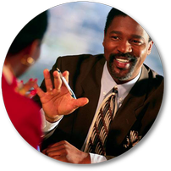



Behavioral Adaptability (H.O. p 6)
Adaptability
The willingness to modify my behavior for the benefit of the relationship.
Golden Rule
Do unto others as you would have them do unto you.
Platinum Rule
Do unto others as they want to be done unto.

Slide 57

Titanium Rule
Do unto others as Jesus would do unto them.

Slide 58
Style Shifting (H.O. p 7)
Knowing your
own style
Recognizing another’s style
Shifting your style: Adapt your approach to meet the needs of the other person

Slide 59
Typical Shifts for Each Style (H.O. p 7)
Highlight 2-3 shifts for your high style:
High D example:
Ask for opinions of others
Negotiate decision-making
Listen without interruptions
Adapt to time needs of others
Allow others to assume leadership more

Slide 60
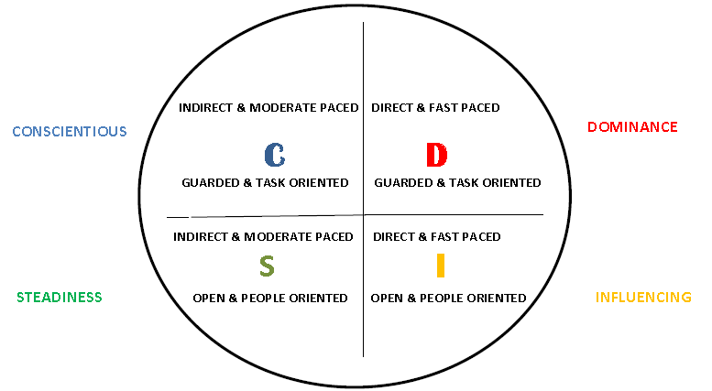
People Reading (H.O. p 8)

Slide 61
People Reading (H.O. p 9)
Name___________________________________
Guarded/Task Oriented OR Open/People Oriented
Direct/Fast Paced OR Indirect/Moderate Paced
Observations: ______________________________________________________________________________________________________________________________

Slide 62
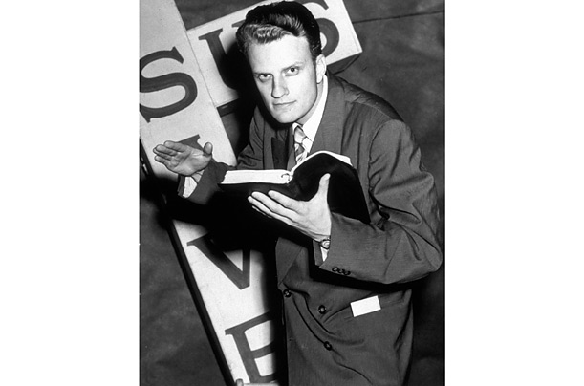
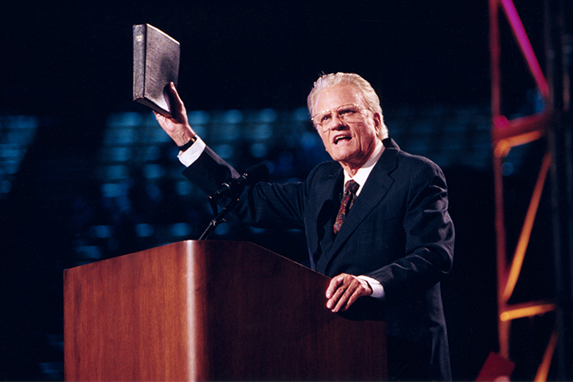
Billy Graham

Slide 63
Adolf Hitler

Slide 64
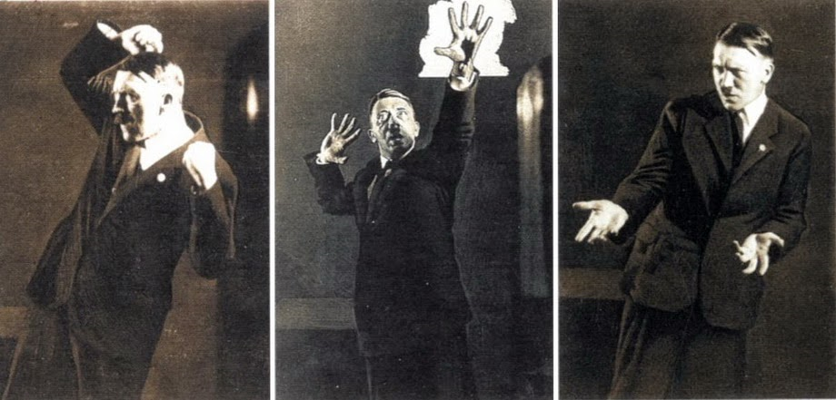
Adolf Hitler

Slide 65
Case Study Application (H.O. pages 10-13)
Work with your assigned case study in groups, first identifying the D-I-S-C style of the person.
Answer the questions shown by determining some ways you would communicate with this person, and what you would avoid doing/saying.
Use Biblical DISC pages 40-43 for reference.

Slide 66
P. 38 How To Modify Your
Directness/Openness
With D’s DIRECT | With I’s DIRECT | With S’s INDIRECT | With C’s INDIRECT
«DI_D» Directness | «DI_I» Directness | «DI_S» Directness | «DI_C» Directness
● Use a strong, confident voice ● Use direct statements rather than roundabout questions ● Face conflict openly, challenge and disagree when appropriate ● Give undivided attention | ● Make decisions at a faster pace ● Be upbeat, positive, warm ● Initiate Conversations ● Give Recommendations ● Don’t clash with the person, but face conflict openly | ● Make decisions more slowly ● Avoid arguments and conflict ● Share decision-making ● Be pleasant and steady ● Respond sensitively and sensibly | ● Do not interrupt ● Seek and acknowledge their opinions ● Refrain from criticizing, challenging or acting pushy – especially personally

Slide 67
P. 39 How To Modify Your
Pace and Priority
With D’s FASTER | With I’s FASTER | With S’s SLOWER | With C’s SLOWER
«PA_D» Pace | «PA_I» Pace | «PA_S» Pace | «PA_C» Pace
● Be prepared, organized ● Get to the point quickly ● Speak, move at a faster pace ● Don’t waste time ● Give undivided time and attention ● Watch for shifts in attention and vary presentation | ● Don’t rush into tasks ● Get excited with them ● Speak, move at a faster pace ● Change up conversation frequently ● Summarize details clearly ● Be upbeat, positive ● Give them attention | ● Develop trust and credibility over time, don’t force ● Speak, move at a slower pace ● Focus on a steady approach ● Allow time for follow through on tasks ● Give them step-by-step procedures/instructions ● Be patient, avoid rushing them | ● Be prepared to answer questions ● Speak, move at a slower pace ● Greet cordially, and proceed immediately to the task (no social talk) ● Give them time to think, don’t push for hasty decisions

Slide 68
pp. 40-41 How to Adapt to Each
DISC Style
AT WORK, HELP THEM TO…
IN SOCIAL SETTINGS …

Slide 69
pp. 42-43 Communication Plan with each DISC Style
CHARACTERISTICS: | SO YOU…
Concerned with being #1 | Show them how to win, new opportunities
Think logically | Display reasoning
Want facts and highlights | Provide concise data

Slide 70



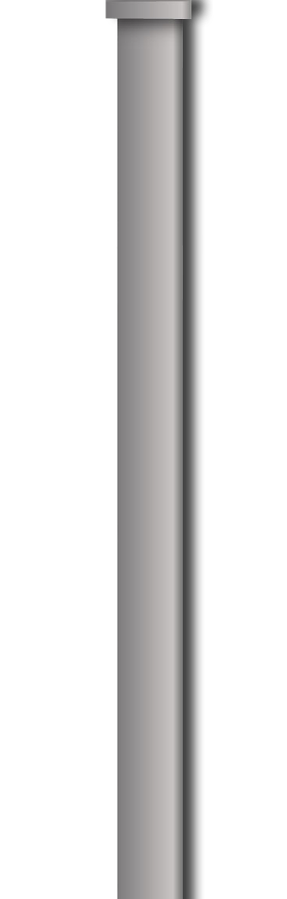
Action Plan (H.O. p 14)
Behaviors I’d like to Start – Stop – Continue using…
This Way

Slide 71
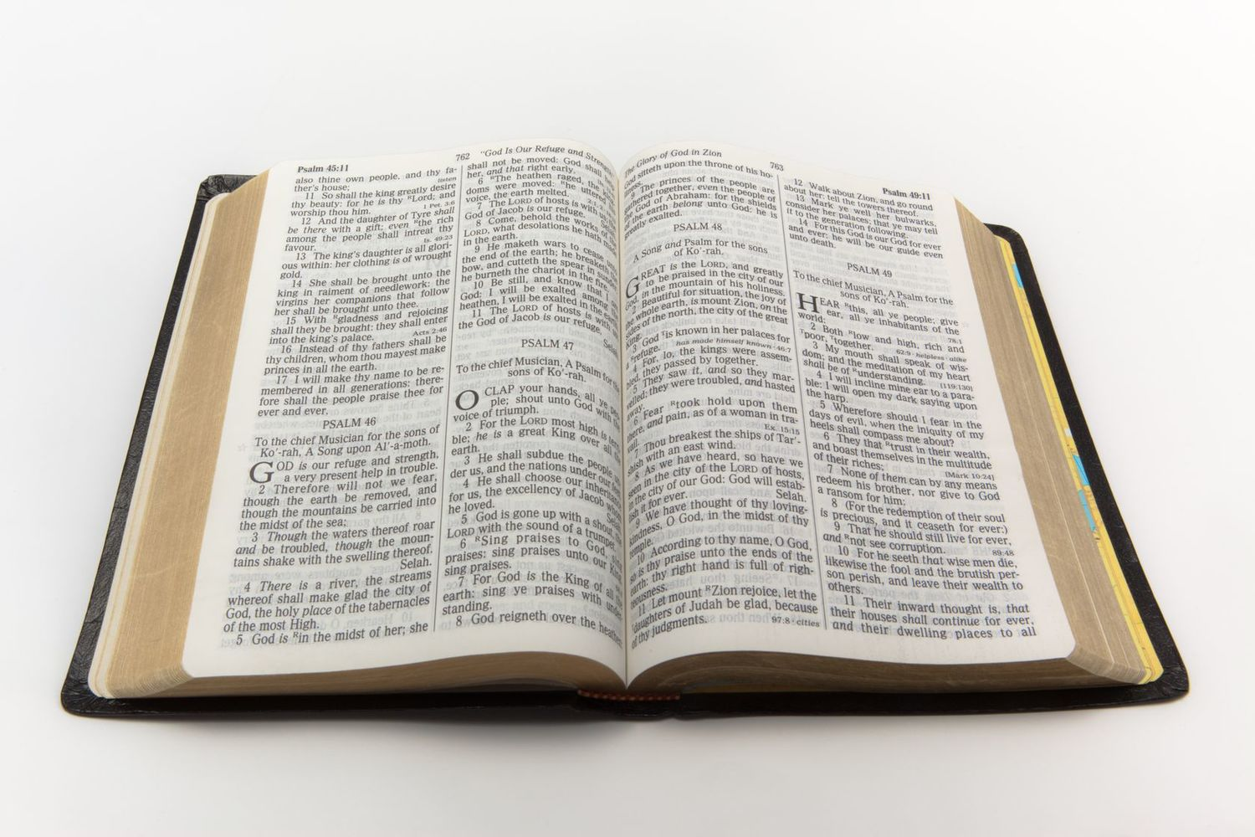
Jesus is our Role Model
“A new command I give you: Love one another. As I have loved you, so you must love one another.” John 13:34 (NIV)

Slide 72
Love Like Jesus
“A new command I give you: Love one another. As I have loved you, so you must love one another.” Jesus
John 13:34 (NIV)

